Slide 1


“Mapping the Market Thought” Approach for forecasting Maize Prices
Brands
Mr. Nagaraj Meda
Managing Director
TransGraph consulting Pvt.ltd
THE INDIA MAIZE SUMMIT’13
Mar 22nd 2013

Slide 2
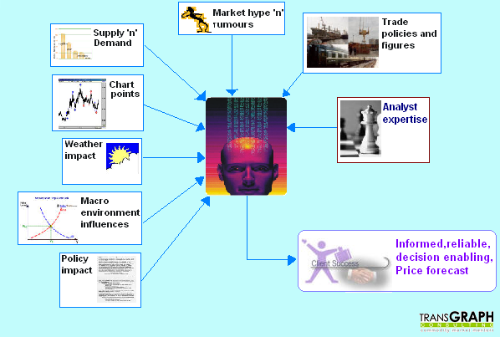
We have a great principle of accommodation which maximizes the utility of various inputs that are available. That is….
Mapping the market thought
Mapping the market thought

Slide 3
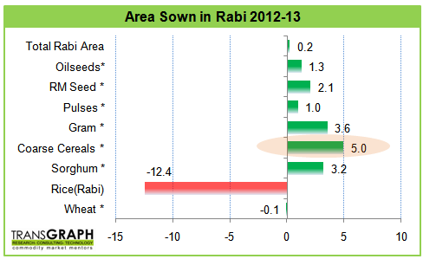
India’s Rabi Crop Sowing Details
Major changes in Rabi crops sowing are:
  Delayed sowing in majority of the regions
  Rice acreage diverted towards other lucrative crops
  Increase in acreage under Coarse Cereals due to water scarcity
  Among coarse cereals Sorghum accounts higher acreage share and followed by Maize

Slide 4
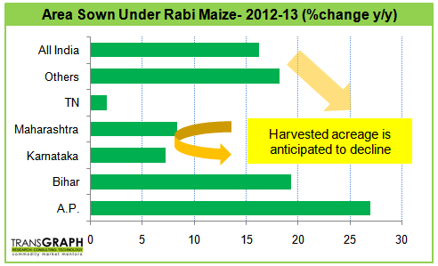
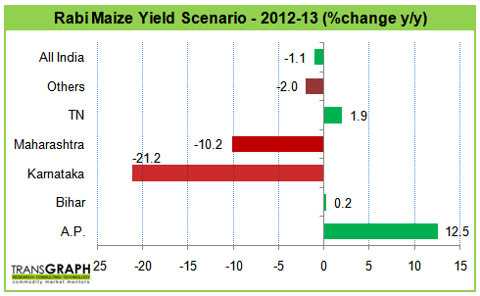
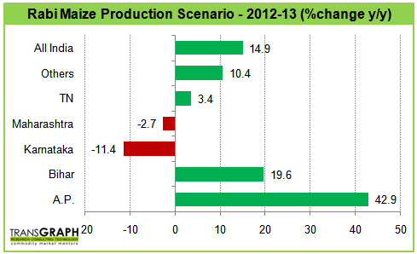
India’s Rabi Maize Production Scenario
India's Rabi Maize Production Projections for 2012-13 (Million tons)
States | 2011-12 | 2012-13 p
A.P. | 2.22 | 3.17
Bihar | 1.29 | 1.54
Karnataka | 0.33 | 0.29
Maharashtra | 0.29 | 0.29
TN | 1.04 | 1.08
Others | 0.32 | 0.35
All India | 5.49 | 6.31

Slide 5
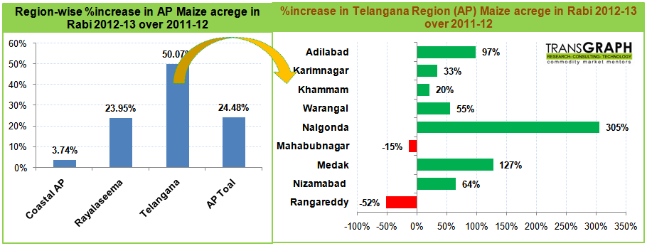
Andhra Pradesh Rabi Maize Status
Acreage under maize in AP considerably increased in Telangana region owing to varied reasons:
Fall in reservoir levels - shifted irrigated rice towards irrigated maize (2.17 Lakh ha of rice shifted towards other lucrative crops like maize, groundnut and pulses crops.
Higher price realization for Kharif maize (Kharif maize price at Nizmabad for Aug’12 to Dec’12 stood at INR 1400 per quintal

Slide 6
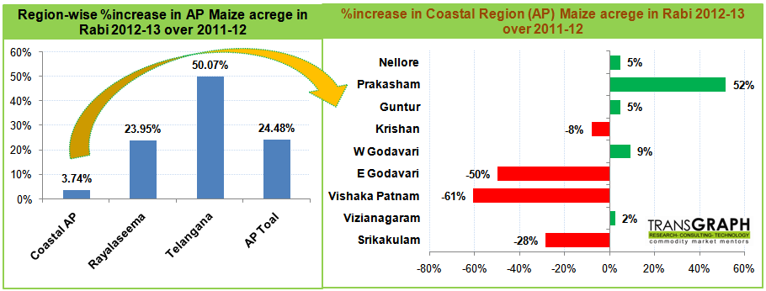
Coastal AP Maize Sowing Dynamics
Rabi maize acreage in coastal region increased by 3.74% and major contribution is from Prakasam and West Godavari.
Farmers at E. Godavari and Vishak Patnam farmers have increased acreage under Rice (and reduced maize) due higher rains in the region (31% and 19% departure respectively).

Slide 7
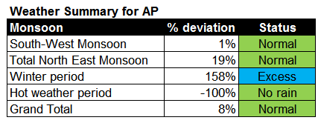
Rabi-2012-13 Maize Production Details
Andhra Pradesh received normal rainfall for the current year.
With frequent showers, maize yields are likely to increase by 12.50% over last year towards 7.65 tons per ha.
In overall, we can expect AP maize production to stand at 3.17 million tons, which is up by 43% over last year.
% contribution of AP to India’s total Rabi maize production is likely to increase by 50%.

Slide 8
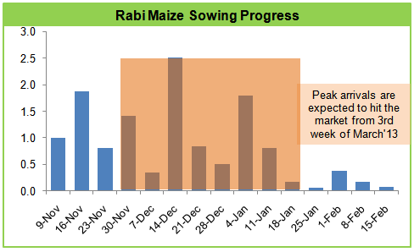
All India Expected commencement of arrivals
Combined with late Kharif harvest as well as variation in arrival of post monsoon rains, Rabi maize sowing postponed from its normal date.
Therefore, peak arrivals are expected to commence from 3rd week of March or First week of Apr’13.

Slide 9
Likely flow of Maize to Karnataka and Maharashtra from AP
Unfavorable Monsoon rains led to-
Karnataka Kharif maize production declined by 5.3% due to decline in harvested acreage and yield rate even though sown acreage was normal/higher.
Same in Maharashtra production declined by 2% due to decline in yield rate as well harvested acreage.
Therefore, we anticipate there will be higher quantity of maize from AP towards Karnataka and Maharashtra.

Slide 10
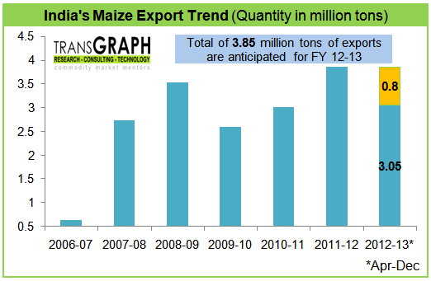
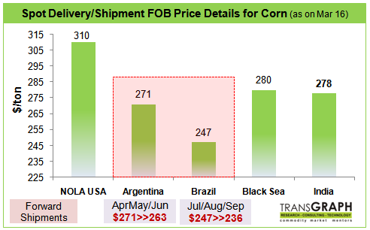
Indian Maize Export Dynamics
Indian maize exports for the three quarters of 2012-13 stood at 3.05 million tons and another 0.7 to 0.8 million ton exports are anticipated in 4Q of 2012-13. (around total 3.85 million tons)
Currently, Indian Maize FOB prices quoted at $278-290 per ton while US corn is costlier by $20-32 per ton ($310-316 per ton).
In the last couple week, Indian maize shipments for a quantity of 94,500 tons happened to the countries like China, Vietnam, Indonesia etc.
Maize starch exports have took place at price of INR 25.2 per kg during the week for a quantity of 90tons to Nigeria.
Looking ahead, nearly 4.5-5 million tons of exports are projected for FY 13-14 owing to higher demand from S. E Asian countries.
  Projected higher Rabi maize output in India
  Prevailing global tight supply condition for corn
  Globally, nearly 13% decline in carryover stocks for 2012-13
  Declined US production for 2012-13
  Nearly 6% decline in global wheat output

Slide 11
Global Happenings
Drought in US
Decline in sown and harvested US corn crop
Last year S. American corn affected by drought and lower stocks with them
Tight Supplies of Corn globally
Higher prices for soymeal and feed demand
Higher Prices for US Corn
(High of 845 cents/bu on 10th Aug’12 )
Estimates for higher corn production from South America
Declined demand from ethanol producer on lack of margin due to higher corn prices
Shift of livestock/poultry feed users to wheat rations
Lack of export demand due to higher prices and tough competition with South America and Ukraine
Current US corn export price $310-315 per ton
Improving weather condition in US
Estimates for higher corn production from US in 2013-14
Medium term Price Impact
Notes:
Currently, US corn prices are getting affected by subdued ethanol demand and export demand.
Corn exports are lowered based on the slow pace of sales and shipments to date and stronger expected competition from South American corn and from competitively priced feed quality wheat.

Slide 12
US Corn Situation
Tight US Corn supply in “old crop” 2012-13
Large US Corn crop estimates for 2013-14
S. America is likely to be price driver for 2013
Attributes | 2011-12 | 2012-13 E | 2013-14 F | %change
Planted Area (mil acre) | 91.9 | 97.2 | 96.5 | -1
Harvested Area (mil acre) | 84 | 87.4 | 88.8 | 2
Yield (bu/Ac) | 147.2 | 123.4 | 163.6 | 33
Beginning stocks (mil ton) | 28.6 | 25 | 16 | -36
Production (mil ton) | 313 | 273 | 367 | 35
Imports (mil ton) | 0.7 | 2.5 | 0.6 | -75
Total Supply (mil ton) | 342.2 | 300.5 | 384.5 | 28
Feed, Residual | 115.1 | 112.7 | 136.7 | 21
Food, Seed | 163 | 149 | 154.7 | 4
Ethanol | 126.9 | 113.9 | 118.4 | 4
Total Domestic use (mil ton) | 278.1 | 261.7 | 291.4 | 11
Exports (mil ton) | 39.1 | 22.8 | 38 | 67
Total use (mil ton) | 317.9 | 284.5 | 329.4 | 16
End Stocks (mil ton) | 25 | 16 | 53.6 | 235
Avg. farm price ($/bu) | 6.22 | 7.2 | 4.8 | -33

Slide 13
Country-wise Corn Market Dynamics
Competition for corn exports is only expected to increase, as Brazil begins exporting more corn and Ukraine continues its exports.
Argentina and Brazil corn production to stand at 27.5 mil ton (+27% y/y) and 72.5 mil ton (+0.7% y/y) respectively.
Argentina and Brazil are anticipated to hit the markets based on weather/ moisture content of the grains and logistics status.
Ukraine has exported near 10 million tons of corn in the 2012/2013 marketing year.
Global total grains supply (production+ carry in stocks) for 2012-13 is decline by 3% y/y to 2146.3 million tons.
Higher food (+0.7%) and decline in industrial (-2.3% y/y) and feed consumption (-2.65% y/y), in total these put ending stocks down by 11% y/y.

Slide 14
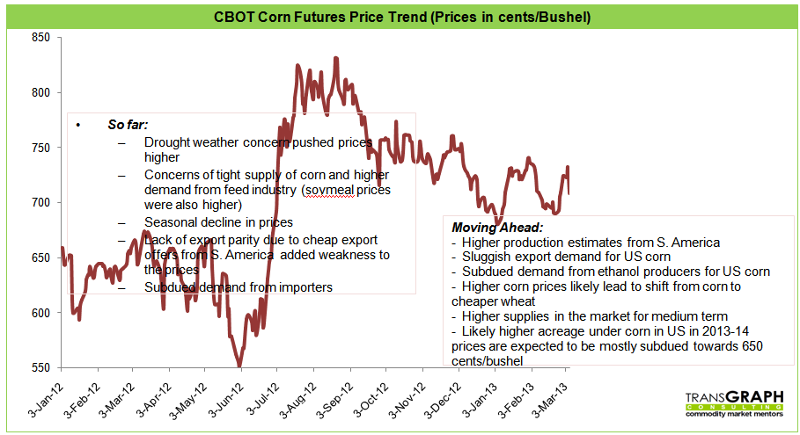
CBOT Corn Futures Trend

Slide 15
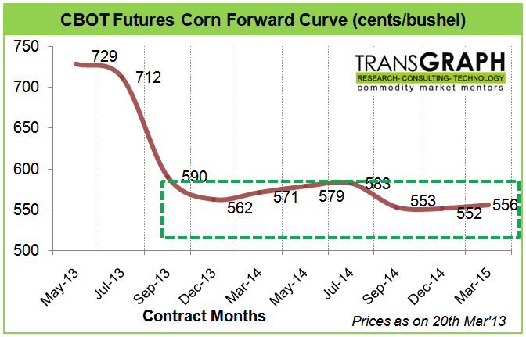
CBOT Futures Forward Curve
CBOT Futures Forward Curve indicates lower prices for Sep’13 contracts which are near 590 cents/bushel against 729 cents/bushel of current price and same indicates current market expectations of higher production for 2013-14 season

Slide 16
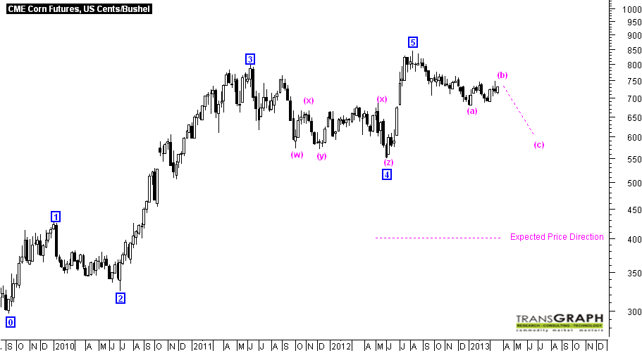
Global Corn:
CME Corn Futures., Cents/bushel

Slide 17
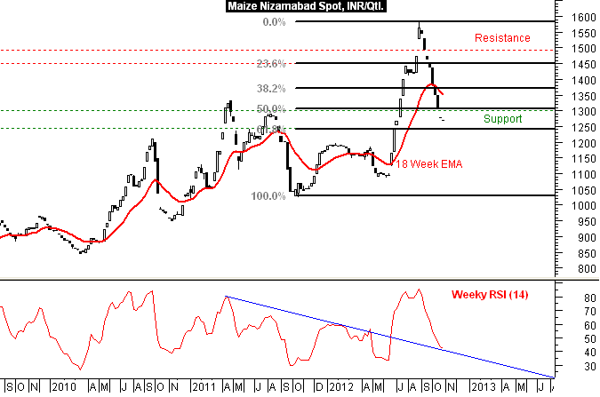
Maize Nizamabad Spot, INR/Qtl.

Slide 18
Price Outlook- Maize
Market & current price |  | JFM’2013 | AMJ ’13 | JAS ’13 | OND’13 | JFM’14
Maize/ Corn (INR 1320/qtl) as on 21st Mar’13 | High | 1360 | 1350 | 1400 | 1300 | 1400
 | Low | 1250 | 1300 | 1350 | 1200 | 1300
 | Avg. | 1300 | 1325 | 1375 | 1275 | 1350

Slide 19
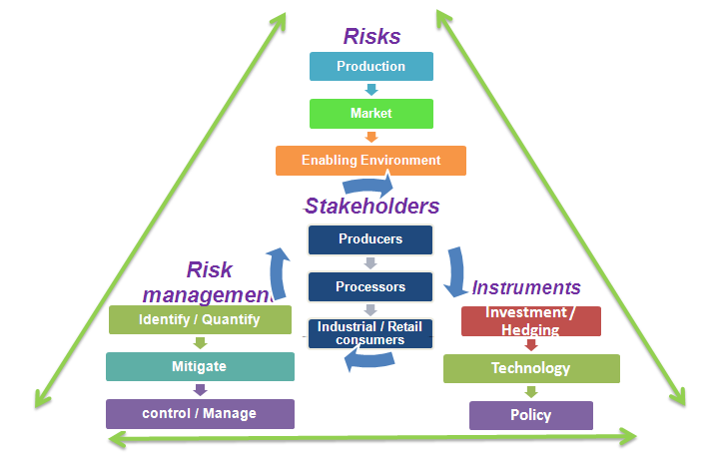
Maize Risk Environment

Slide 20
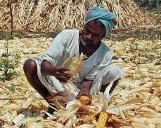
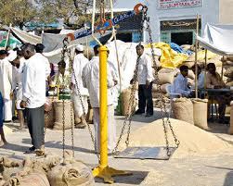
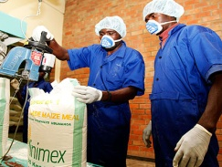
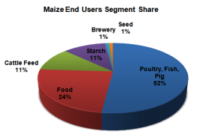
Price Risk
Industry pain point | Challenge | Impact | How to address?
Price Risk | Challenge to deal with unanticipated price changes Difficulty in securing long term contracts | Impact on entire value chain Farmers’ income Sharp Changes in acreages P&L impact for businesses Supply adjustment to prices | Can mitigate risk by proper use of hedging mechanism: Physical and financial hedging Long term tie ups

Slide 21
Volatility in Maize Prices

Slide 22
Maize Price Avar

Slide 23
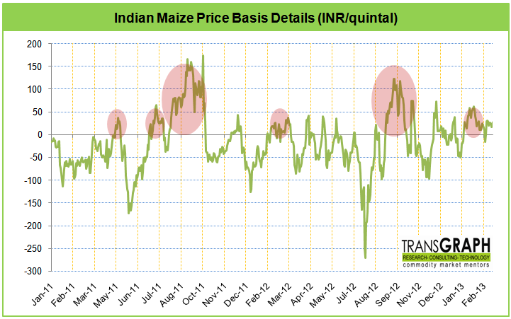
Basis – NCDEX Future prices – Nizamabad spot
Basis turns positive before new arrivals begin to markets
Making strategies for purchase and sale by tracking basis movement

Slide 24
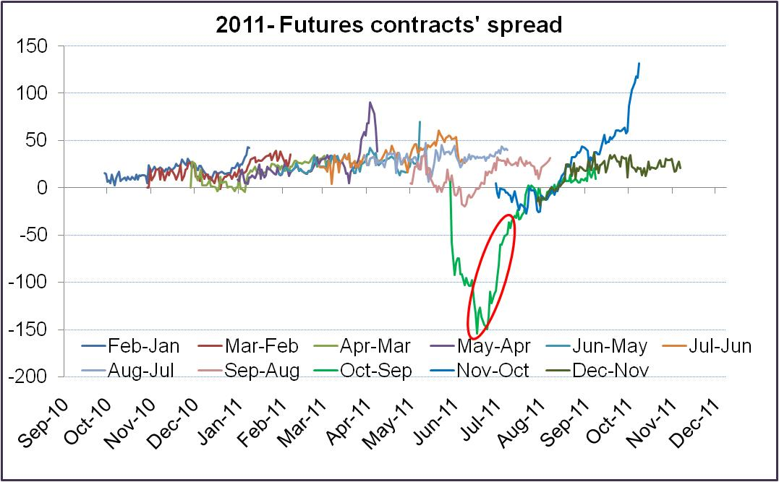
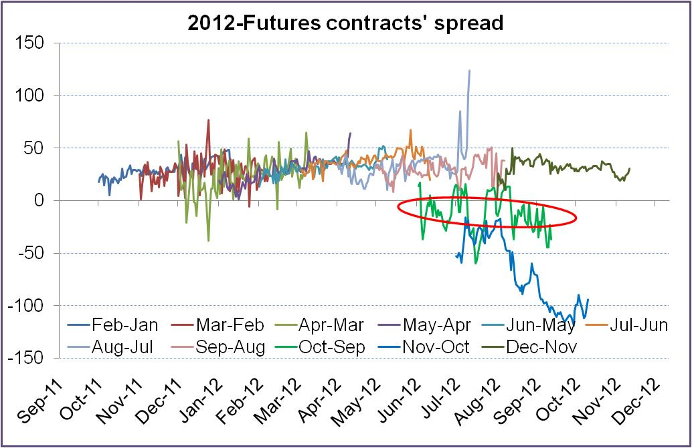
Futures spread between contracts

Slide 25
Production Risk
Pain Point | Challenge | Impact | How to address?
Production Risk | Weather Input availability & prices of inputs Competitive crops and price realization Crop holding Size Quality damage | Impact at each point in value chain Volatility in supplies Lack of quality material availability Price volatility Crop diversion Shift to alternatives | Timely Decision making: Irrigation; improved early warning systems; & adoption of better agronomic practices; Contract Farming; Warehousing; Weather Insurance; Buffer stocks/reserves.

Slide 26
Demand side Risk
Pain Point | Challenge | Impact | How to address?
Demand side Risk | Changing habits of end consumers -Faster adoption Availability of Alternatives and price fluctuations Export market behavior for Maize and products | Impact on revenues Time taken to adjust to new set of demands / markets | Analysis /updated market demand dynamics and staying ahead of the curve
Demand for industrial products- Starches, LG, Polyols (like Sorbitol, Mannitol) – increasing in double digits along with rising FMCG sector growth.

Slide 27
Global Environment
Pain Point | Challenge | Impact | How to address?
Global Environment | Increasingly, Indian and global prices more correlated Global shortfalls leading to sharp rise in domestic prices | Diverged impact for trading companies and domestic consuming industries | More value addition at domestic level and improving the overall domestic Maize economy

Slide 28
Policy Risk
Industry pain point | Challenge | Impact | How to address?
Policy risk | Unexpected Government intervention Ex. Export ban State-wise different tax structures/policies, impacting logistics | Impact on planning infrastructure establishment/capital Impact on traders- likely sudden loss of export/import opportunity | Very little alternatives available Unison of all the stakeholders for commonly acceptable policies Approach towards a more free-market maize-economy

Slide 29
Critical Risk Drivers for Industry
Critical pain points for stake holders in Maize Value Chain:
1
Production-supply side concerns
Market-demand side concerns
Enabling Environment-policy interventions
Price Fluctuations
Volatility
Budget Deviation
Global Environment
2
3
4
5
6
7

