Slide 1
Un-certainty in Markets
Management of Risk
Amit Sachdev
India Representative
U S Grains Council

Slide 2
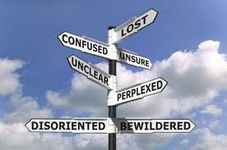
Meaning
The quality or state of being uncertain; in DOUBT
Synonyms:
distrust, distrustfulness,
dubiety,
dubitation[archaic],
incertitude, misdoubt,
misgiving, mistrust, mistrustfulness, query,
reservation, skepticism,
suspicion, doubt

Slide 3
Quotes
If you aren't in the moment, you are either looking forward to uncertainty, or back to pain and regret. Jim Carrey
The only thing that makes life possible is permanent, intolerable uncertainty; not knowing what comes next.
Ursula K. Le Guin

Slide 4
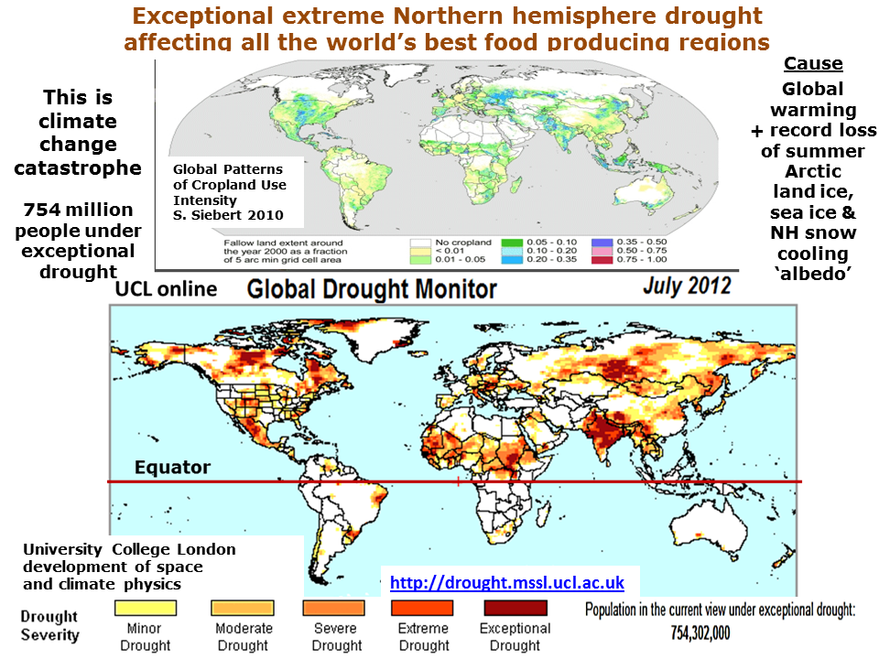
Un-certainties the world faces
The 5 F’s
Food
Feed
Fodder
Fuel
Finance
Weather
Decisions taken now in times of un-certainty will have an effect on our long term profits.
Times could be uncertain always and Indian farmers have always been on the receiving end, be it floods or drought – vagaries of nature have affected production many a times.

Slide 5
Where is the demand coming from
The Indian agri-commodity prices are linked to the international markets and it is the urban population that is increasing all over the world and putting pressure on the demand.
In 2008 the world’s urban population was more than 3 billion and exceeded the rural population and by 2020 more than 75 percent people in the developing nations in Africa, Asia and Latin America will be staying in urban centers – FAO Report

Slide 6
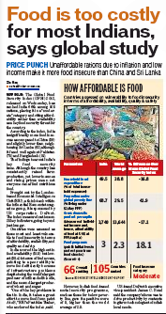
Indian Demographics
Indian demographics are changing fast and India is also experiencing that shift from a rural agrarian base to urban non-agriculture base. As people shift base, it leads to an increase in urban poverty and urban food security. High food inflation also is part of the scenario and will continue.
Commodity prices will remain volatile and higher

Slide 7
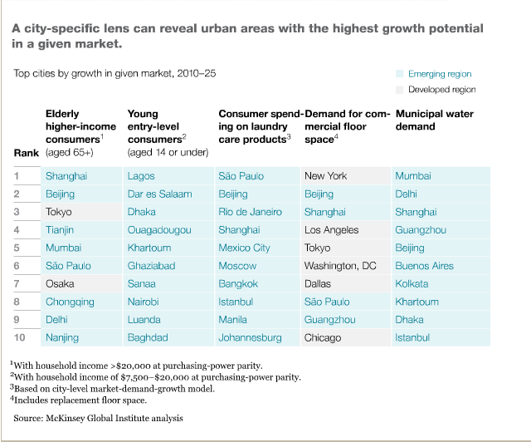
India
MGI research estimates: Indian cities could generate 70 percent of net new jobs created to 2030, produce around 70 percent of Indian GDP, and drive a near fourfold increase in per capita incomes across the nation.
But to to that India needs to invest $1.2 trillion just in capital expenditure in its cities over the next 20 years, equivalent to $134 per capita per year, almost eight times the level of spending today.
India needs take on a policy challenge and make it possible
If this does not happen, growth would slow down, rating could go down and the risk is higher unemployment.
Farmers selling land in areas close to cities at high price. Some leaving agriculture altogether, other buyer land in the interior of the state)

Slide 8
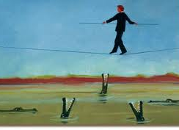
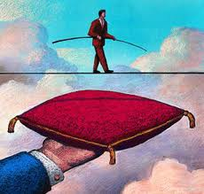
Managing Risk
Now we know that the industry (any) or government for that matter is vulnerable – what is the the next step
Managing risk (taking a calculated risk) is probably most important at these times
Farmers and people do it all the time.
In the US farmers do it all the time – day in – day out – then why not us

Slide 9
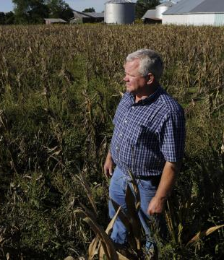
Risk Cover for an un-certainty
Small premium paid for insuring - medical or life….
Complete loss --but there is risk cover………
For day to day running of plants …..inputs …..is there a risk management tool.

Slide 10
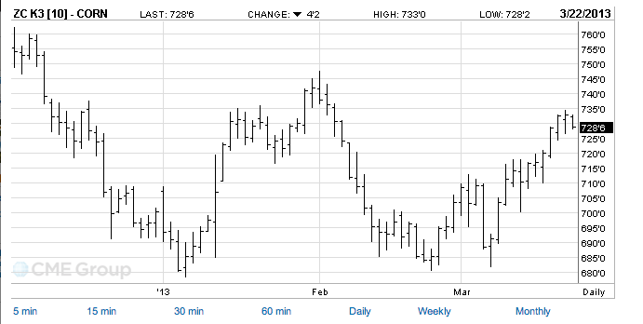
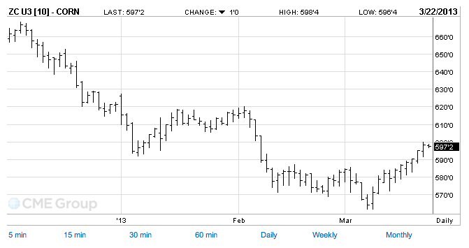
Scenario
US corn market - Thursday close $288.56 per MT
$283.44 per MT – Monday
Has it leveled……
Or is it too early to say it has leveled and now the prices will remain stable or can slide lower ?????????

Slide 11
Low – stable prices – could be a temporary phenomenon
More animals are being slaughtered – leading to higher supplies – reason – farmers unable to cope up with higher feed prices – but eventually when it is over – prices will rise. It is not the wheat and rice prices that are rising now….it is the coarse cereals and protein meals.
There is a huge risk for those who are in animal protein business and those who consume animal products.

Slide 12
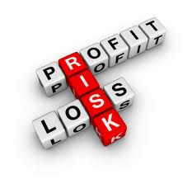
Risk and its management is what differentiates profit and loss

Slide 13
Maize Prices: Courtesy: NCDEX, Poultry Prices: Courtesy: Poultry Technology

Slide 14
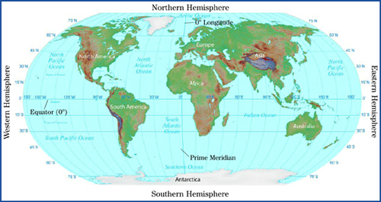
More un-certainties
Southern Hemisphere is just starting to harvest corn (Brazil and Argentina).
From now on until April – May 2013 – there are many un-predictable(s), especially the weather – will in rain in Bihar???
How much corn will US plant……
If the prices of corn remains low then the demand could increase….exports could be higher and ending stocks numbers could change within next 3 – 4 months……
Which would mean – higher prices yet again
Considering the above facts …….
current levels could be temporary
BUT Then there is that RISK …..
if that happens, am I covered…….

Slide 15
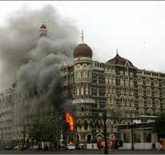
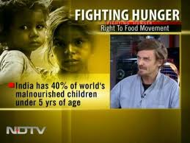
What is more risky….for India
Acts of Terrorism
Poverty and Hunger

Slide 16
Solutions to fight un-certainty
Investment for infrastructure, rather than input subsidy
Encouraging – backward and forward linkages
Crop insurance – safeguarding the interest of the farmers, income should increase by increasing productivity not increasing MSP
Policy change and enforcement– especially APMC and Essential Commodities Act (connecting the end users directly with farmers)
Policy for open trade – import and export rather than bans (follow the rules of the trade and market intelligence)
A proper futures market, which is used as a risk management tool by the sellers (farmers) and users (Processers etc) to hedge their risks.

Slide 17
Thank you very much for a patient hearing

