Slide 1
FUTURE CHALLENGES FOR EQUIPMENT MANUFACTURERS
Michel SIEBERT, President of KUHN GROUP

Slide 2
Introduction – Presentation of the KUHN GROUP
1. Environment
Major trends
Major differences
2. Challenges faced by implement manufacturers
Common challenges for all manufacturers
Specific challenges for implement manufacturers
3. Success factors
Conclusion

Slide 3
Introduction – Presentation of the KUHN GROUP
1. Environment
Major trends
Major differences
2. Challenges faced by implement manufacturers
Common challenges for all manufacturers
Specific challenges for implement manufacturers
3. Success factors
Conclusion

Slide 4
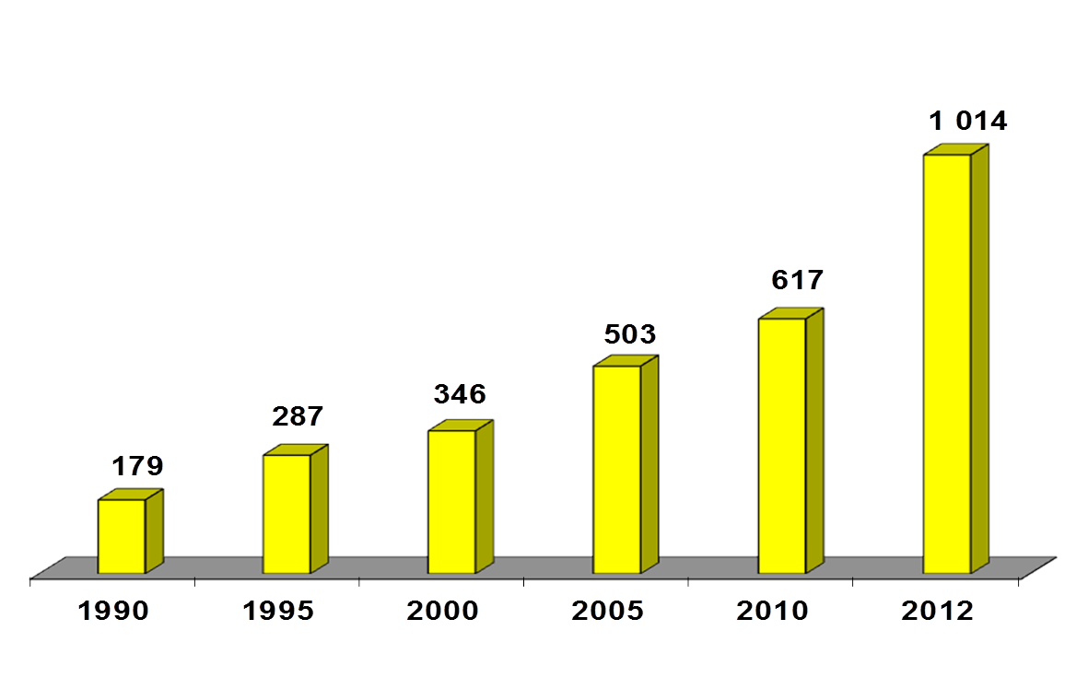
KUHN GROUP’S Evolution

Slide 5
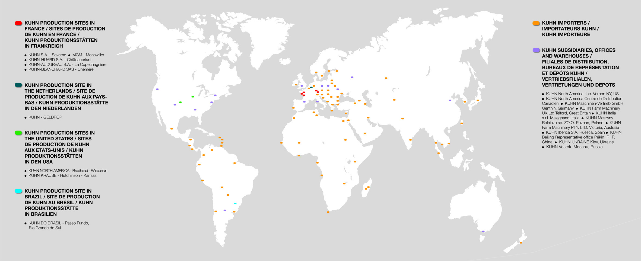
KUHN GROUP’S World Presence
Today, KUHN Group is made of:
9 Production Business Units
11 Distribution Business Units.
Marketing and distribution in approximately 100 countries across the globe.

Slide 6
KUHN GROUP’S Production Units
KUHN Saverne
KUHN
Passo Fundo
KUHN Châteaubriant
KUHN Hutchinson
KUHN
La Copechagnière
KUHN Brodhead
KUHN Chéméré
KUHN Geldrop

Slide 7
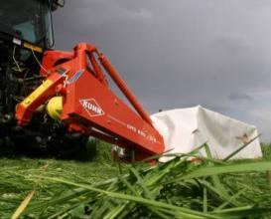
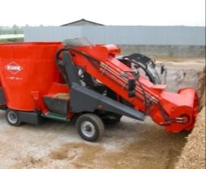
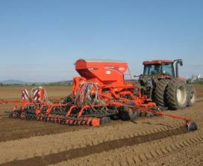
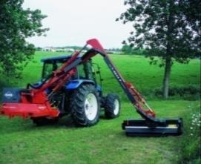
KUHN GROUP’S Product Portfolio
10 complementary product lines forming 4 Product Platforms
Hay & Forage – Livestock – Crop Production – Landscape & Road Maintenance
Dairy & Meat Production
Crop Production
Environment Maintenance
Hay & Forage
Mowing
Mowing-Conditioning
Tedding
Raking (incl. Merging)
Baling
Wrapping
Maize chopping
Livestock
Feeding
Bedding
Crop Production
Ploughing
Tillage
Seeding (incl. Planting)
Fertilization
Manure Spreading
Spraying (field, orchard)
Landscape & Road Maintenance
Shredders (field, landscape)
Salt & Sand Spreading
Spraying (Amenity, others)

Slide 8
The Foundations of KUHN GROUP’S Strategy

Slide 9
Introduction – Presentation of the KUHN GROUP
1. Environment
Major trends
Major differences
2. Challenges faced by implement manufacturers
Common challenges for all manufacturers
Specific challenges for implement manufacturers
3. Success factors
Conclusion

Slide 10
Environment
2006 … The Comeback of Agriculture!
Positive evolution for both developed and developing markets

Slide 11
The Worldwide General Environment
The worldwide agricultural economic environment provides multiple opportunities for growth and innovation
9.6 bn people in 2050 and probably 10.9 bn in 2100
Limits in the availability of ag. land and water
Climatic changes
Major progress will have to come from improved yields and storage/handling
Mid/Long-Term trends are positive
The concentration process will continue
New actors are appearing

Slide 12
The Worldwide General Environment
But… there are major differences across regions
Innovation, precision farming, data management and other productivity based farming solutions in mature markets.
Efficiency through gradual mechanization in fast growing emerging markets using technologies previously proven in the mature markets.
Different growth potential will affect various parts of the world
Quality concerns regarding nutritional value/origin of food will offer opportunities
Growth will differ by region and type of demand

Slide 13
Introduction – Presentation of the KUHN GROUP
1. Environment
Major trends
Major differences
2. Challenges faced by implement manufacturers
Common challenges for all manufacturers
Specific challenges for implement manufacturers
3. Success factors
Conclusion

Slide 14
Common Challenges to Meet the Requirements of the Farmers
Serve the growing population with agricultural products despite a less constant arable land area
Master the management of water resources and the effects of climatic changes
Respect the environment and contribute to the reduction of the greenhouse gas emissions
Reduction/end of subsidies
Complexity
Volatility

Slide 15
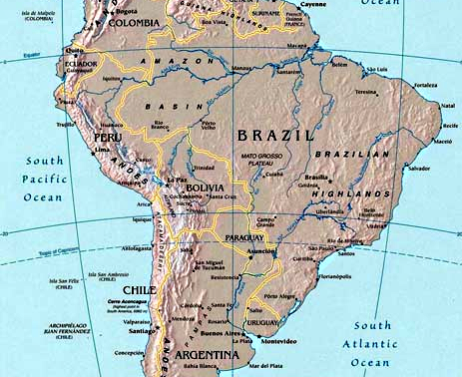
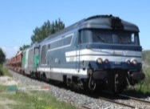
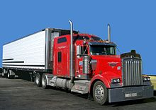
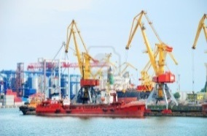
The Importance of Logistics
The example of Brazil
From Mato Grosso to the ocean
Importance to have:
Roads
Highways
Railways
Ports
X

Slide 16
Specific Challenges
New technologies and regulation evolutions
Electronics and Product Information Technology have a high potential to:
Improve the efficiency and productivity of farm machines
Save labour
Reduce waste
Conserve natural resources
Protect the environment
Increase input efficiency of seed, fertilizer and water
Etc.

Slide 17
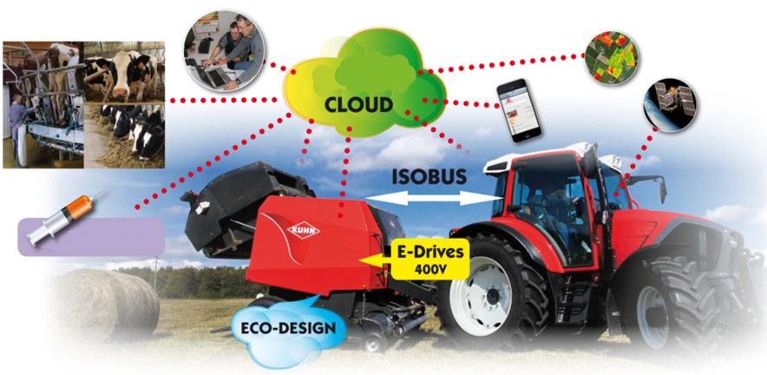
Some Examples of New Technologies
Nutritionist
The
Veterinary

Slide 18
Introduction – Presentation of the KUHN GROUP
1. Environment
Major trends
Major differences
2. Challenges faced by implement manufacturers
Common challenges for all manufacturers
Specific challenges for implement manufacturers
3. Success factors
Conclusion

Slide 19
The World Equipment Suppliers Matrix
Global
Regional
National
Niche
Short Liner
Long Liner
Major

Slide 20
Success Factors
Long-term consistent strategy
Sustainable growth
Early detection of the continuous evolving farmer needs
Master the Quality-Performance-Innovation triangle
Master the diversity in the Ag equipment needs
Master the technological changes
Innovation
Service
Flexibility
Workforce management

Slide 21
The Kuhn Group’s Company Project ONE

Slide 22
Success Factors
Wayne Gretzky, former Canadian
ice hockey player:
“I skate to where the puck
is going to be, not to where it is or has been”

Slide 23
Thank you for your attention !
Michel SIEBERT, President of KUHN GROUP

