Slide 1


AEF – Ag Industry’s initiative in electronics standards implementation

Slide 2


Introduction
Peter van der Vlugt
  AEF - Chairman
  Kverneland Group – R&D Manager

Slide 3
Overview
Electronics Standards
ISOBUS introduction and history
Founding of the AEF
AEF Organization and Products
AEF Future
Customer benefits
Conclusion

Slide 4
Electronic Standards
Reasons for a Global Standard:
Farmers buy different brands of implements and tractors
Solve the ‘Island solutions’ problem
Need for standard tractor - implement connection (‘Electronic PTO’)
Provide a solid power supply
Connecting to third party systems should become ‘plug & play’
Communication with tractor electronics
One common Universal Terminal (UT) definition
Data exchange Mobile system to Farm Management

Slide 5

Electronic Standards
Since 90s rapid increase of Electronics in Tractors and Implements
Protocol needed for data communication between tractors and implements based on CAN
The most important standard developed was ISO-11783

Slide 6
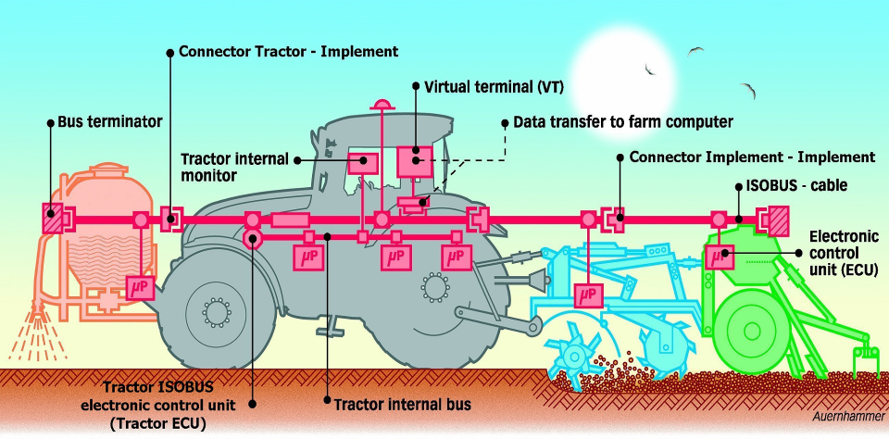
Electronic Standards

Slide 7
ISOBUS Introduction & history
ISO-11783 commonly named ISOBUS
ISOBUS started slowly in 2001
Since 2005 rapid growth in ISOBUS applications
Many companies involved worldwide, but:
  Different interpretations of the standard
  Incompatibility issues
  Different marketing approaches; e.g ISOBUS ”Prepared”, ISOBUS ”Light”
→Customer frustration and confusion!

Slide 8
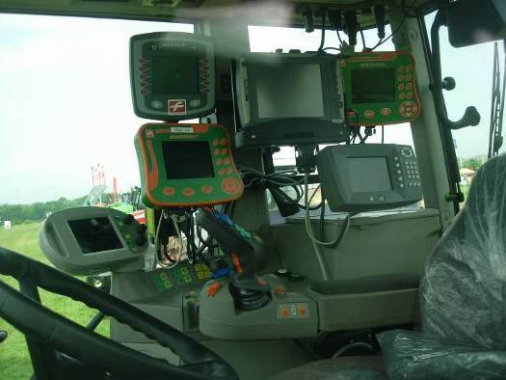
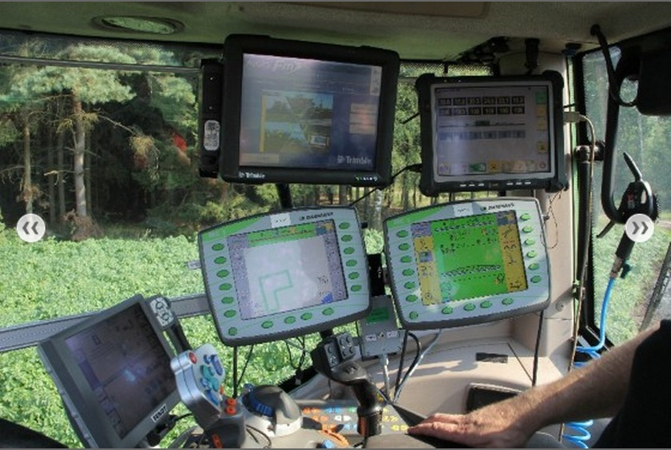

Slide 9
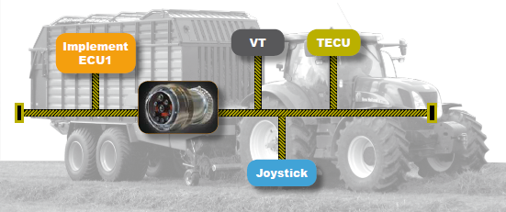
Ag Industry Awareness
Only one testing institute: DLG
Typical ISOBUS systems sold in high quantities
Still incompatibility issues in the field
Non-aligned, unstructured approach to market
ISOBUS ‘prepared’ or ‘light’, what does it mean...?
In practice: Customers losing confidence!

Slide 10
Founding of AEF
Agricultural Industry Electronics Foundation
Founded on October 28, 2008 by
7 major agricultural equipment manufacturers and 2 associations
Kverneland Group is one of the Founding Members

Slide 11





Slide 12

The realization of electronic standards in the Ag Industry can only succeed if the global acting players of the Ag industry will accept and enforce them.

Slide 13
AEF Objectives
Coordinate the international development of electronics for farm machinery
Implement electronic standards
Management and enhancement of certification tests
Coordinate technical improvements (e.g ISOBUS)
Build partnerships between ag equipment manufacturers & suppliers
Organize certification support, training, workshops, marketing activities and consulting
Coordinate and address common supplier problems

Slide 14
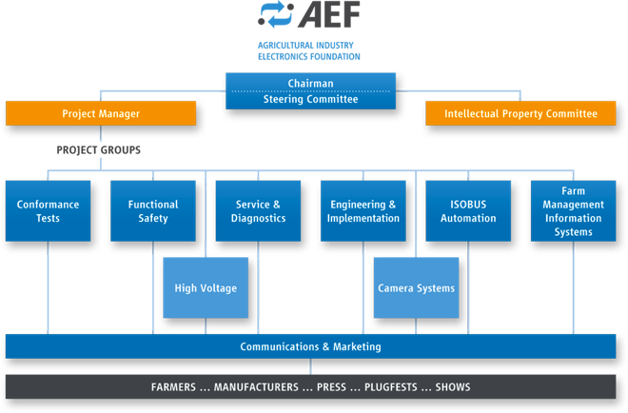
AEF Organization
Peter van der Vlugt, Kverneland Group
Marcello Mongiardo, CNH

Slide 15
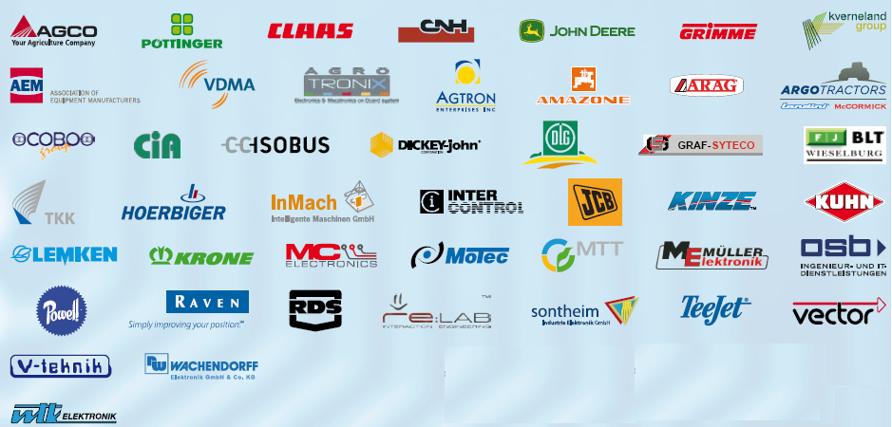
AEF Members
October 2013: Total 150+ members:

Slide 16
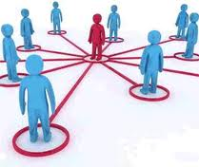
AEF Project Teams
Hundreds of engineers & marketing experts work together and develop guidelines to implement the standard(s):
PT1: Conformance Test
PT2: Functional Safety
PT3: Engineering & Implementation
PT4: Service & Diagnostics
PT6: Communication & Marketing
PT5: ISOBUS Automation
PT7: High Voltage
PT8: FMIS software
PT9: Camera Systems

Slide 17
AEF Products Today
Component certification with AEF Conformance Test
AEF online ISOBUS database
Organization and hosting of Plugfests
AEF publishes guidelines; e.g Functional Safety or Implementation guidelines

Slide 18

AEF Certified equipment

Slide 19
AEF accredited Test Labs
TCI = Test Center ISOBUS (Wallenhorst, Germany)
REI = Reggio Emilia Innovazione (Reggio Emilia, Italy)
NTTL = Nebraska Tractor Test Laboratory (Lincoln, Nebraska, USA)
DLG = Deutsche Landwirtschafts-Gesellschaft (Gross Umstadt, Germany)
AEF Test Lab auditing and accreditation by ENAMA according to ISO-17025 process

Slide 20
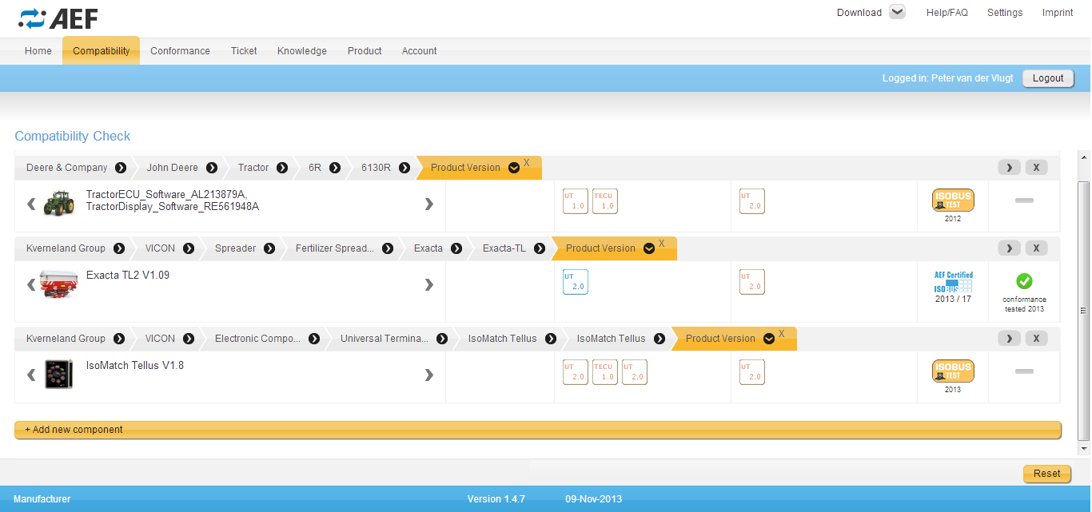
AEF Database

Slide 21
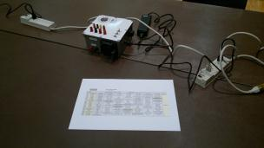
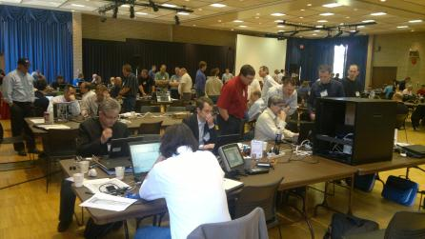
AEF Plugfests

Slide 22
AEF recent and new activities
ISOBUS (Tractor-Implement) Automation
FMIS (Farm Management Information Systems)
High Voltage systems / Electrification
Camera Systems
Wireless Communication (New)
High-speed Bus system (New)

Slide 23
Customer benefits
Ensured compatibility between different brands
Plug and Play
Simplify tasks and work
Global diagnostics & service
Data collection and data exchange
More efficient machine combinations
Ag Industry working together on global challenges
→ Investment security for farmer/contractor!

Slide 24

Conclusion
Complex standards require coordination and cooperation
Ag Industry successfully joined forces in 2008
Over more than 150 members today
AEF matured in 5 years to central platform for Electronics Standards implementation and preparation
Electronics Standards succeed because global acting players accept, align and enforce them

Slide 25
More AEF Information
AEF website: www.aef-online.org
Sign-up for Newsletters
Member subscription on website
AEF booth on major Ag shows

