Slide 1


Managing Quality of Human Resources
A must for having an overall Quality Culture
By
Mr. Sidharath Tuli
Vice President (Human Resources)
3rd FICCI Quality Systems Excellence Awards

Slide 2

Yes! We have No Espresso!!!

Slide 3
The Starbucks Story
Circa 2007
Decreasing Operating Margins
Declining Customer Ratings
In Jan 2008
Founder Howard Schultz returns as the CEO
Emphasized returning to the original values
2014
More than 23000 stores
Revenue of more than US $ 15 Bn
Devoted time to intensive staff retraining
Focused on inspiring employees/partners
Around 14000 stores
Improved HR practices
Increase of 24% in Net Income to US $ 2 Bn

Slide 4

Quality Culture - Xerox
In the late 70s-Japanese entered the US market and were selling cheaper copiers
Xerox lost its market share, down from 90% to 15%
Mr. David Kearns became CEO of Xerox in 1982
He adopted Quality Culture
  No inventory
  No Inspectors
  Managers as support
Within Seven Years Xerox got back its market share

Slide 5







Quality Culture - Xerox - Today

Slide 6
Ways in HR Impacts Quality
Quality
Vision Communication
Preparation for Implementation
Creating Quality Awareness
Developing Management Support
Providing Training
Organizing Workshops
Sustaining via PMS

Slide 7
Quality Culture
Leaders create an environment with a unique personality and soul, and with a passion for quality
A true high-quality organizational culture provides a company with its single greatest source of competitive advantage.
Shared beliefs, values, attitudes, goals and actions, at all levels in an organization, and focused on the superior execution of agreed actions.”
But very few companies actually succeed in building a Quality culture, and even the ones that do so find it hard to maintain.

Slide 8
HR in Business Excellence
Baldrige Criteria for Performance Excellence Framework
A Systems Perspective
Organizational Profile
Environment, Relationships & Strategic Situations
2
Strategic Planning
5
Workforce
Focus
1
Leadership
7
Results
3
Customer Focus
6
Operations Focus
4
Measurement, Analysis & Knowledge Management

Slide 9
HR in Business Excellence
The Business Excellence Model / EFQM Excellence Model
ENABLERS
RESULTS
Leadership
People
Processes
People Results
Key Performance Results
Policy & Strategy
Customer Results
Partnership & Resources
Society Results
INNOVATION AND LEARNING

Slide 10
HR in Business Excellence
Deming Prize Guide
1.Management Policies and Deployment
Core Quality System
2.New Product Development , work Process Innovation
3.Maintenance and Improvement
5.Information analysis and Utilization
6.Human Resources Development
4.Management System

Slide 11
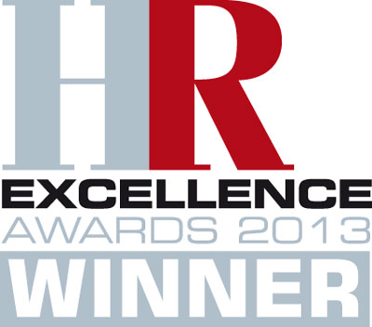
Quality of HR in L&T

Slide 12

HR Excellence - Objectives
To increase alignment towards Business
To aid HR in serving its internal customers better
To establish a culture that encourages reflection and facilitates continuous improvement
To assess our performance,
and identify improvement areas
To be a beacon light in “ Next Practices”

Slide 13
HR Excellence - Initiation
Concept of HR Excellence Model germinated
Designing of Model Criteria & Framework
Sessions with Senior HR/Business Leaders.
Launch of HR Excellence Model & Kick off of the First Wave of Assessment
Aug 2009
June – July 2009
Feb – May 2009
Jan 2009
Notes:
Formation of team in Jan 2009
KV note issued on 1st July 2009 on team formation
Draft presentation by Team in HR Council meet at Nagpur to senior HR leaders of Hydrocarbon and Power IC
Changes incorporated and presented to Mr U Dasgupta and Other senior Business leaders from Hydrocarbon and Power
Feedback added suitably and presentation made to KV for his inputs.
Final version of model released in Aug’ 2009 and termed as wave 1 of assessment.
First field trial of model concluded in Jan’2010. Based on experiences many changes has been done and 2nd version of model launched in Sept’ 2011 for 2nd Wave.
While small tweaking is done after that also based on assessors feedback, and experience the core of model remained same in 4thwave also which just concluded in May’13

Slide 14
HR Excellence - Model
Focus Areas
Leadership & Strategy
People Basics
Talent Acquisition
Learning & Development
Workforce Engagement
Communication

Slide 15
HR Excellence - Assessment
Focus Areas
Process (70%)
Result (30%)
Learning
Deployment
Approach
Level
Trend

Slide 16
HR Excellence - Focus Area - People Basics
Ensure the basic processes like policies and benefits administering are carried out in an efficient and effective manner
Mechanism to address queries and grievances of all workforce spread across locations & sites
Meeting employee service level expectations
Effective implementation of PMS with focus on feedback
Separation process , retention of high performers, feedback from exit interviews

Slide 17
HR Excellence-Focus Area-Talent Acquisition
Covers processes by which talent is recruited and transitioned into assignments in an effective and efficient manner.
Pre
  Capacity building (Sourcing of right talent & numbers)
  Aligning to business requirements
  Brand building
  Cost effective channels of recruitment
  SLA’s for process
Post
  Induction and orientation
  Facilitation of new joinees
  Interactions and feedback
Notes:
By aligning HR messages and recruitment policies with those attributes for which the company wishes to be known, HR becomes a powerful force for attracting talented employees with the right ethos for the company
It is the job of HR to understand the business strategy and employ the pivotal talent that can bring that strategy to reality
HR to provide insights into labour market, educational trends and other talent related factors when crafting corporate vision
HR to analysis whether the company’s long term goals can be supported by labour market demographics
Strategic ability to find and motivate the right talent and the administrative know how to correctly allocate employee resources and manage costs

Slide 18
HR Excellence - Focus Area - L&D
Ensures the organization understands the skills and competencies required to achieve strategic goals and ensures that T&D plans help people match the skills and future capability needs of the organization.
Capability building
Training aligned to goals of the business
Identification of critical skills, Job person fit
Employee development needs
Knowledge transfer
Emphasis on training for workmen and staff
Focus beyond classroom training
Effectiveness & Efficiency of training processes
Special focus on HR team’s capability building
Notes:
How are critical skills identified and what steps are taken to bridge the gap
Capability building – receiving of timely training. What is the unit doing for leadership development
Development needs – Job rotations, job enrichment
Rehiring of ex employees

Slide 19

HR Excellence - Focus Area-Employee Engagement
Ensures the organization engages, compensates, and rewards their workforce to achieve high performance. Assess the workforce Engagement and use the results to achieve higher performance.
Retention of new recruits
Linkage of engagement activities with performance at work
Non Monetary reward and recognition programmes
Actions based on outcome of Surveys
Focus on Employee bonding Vs
Employee engagement
HR presence at site
Stay interviews

Slide 20

HR Excellence-Focus Area-Communication
Ensures the organization understands the communication needs and expectations of the people, develops communication policies, plans and channels. Enables and encourage the sharing of information achieving a dialogue throughout the organization.
Mechanisms of communication (Top down, Bottom up)
Evaluate effectiveness of communication channels
Coverage of all locations and sites
Shared understanding of communication
Sharing of actions based on feedback
Handling of work issues
Notes:
Process

Slide 21
HR Excellence - Focus Area - Benefits
Provides a focused & structured approach to build and improve effectiveness of HR processes & services to our customers
Opportunity to reflect on Unit’s internal strengths and improvement areas.
Creates a culture of improvement orientation (APIP) to achieve Excellence in HR system and processes
Facilitates Benchmarking and sharing of internal best practices
Application writing is an intensive exercise which helps Units to reflect on its processes and generate ideas for further improvement.
Ensures equal importance to each focus area
Notes:
The benefit to having this model is multi fold. First is at concept level itself.
The model provides a focussed and structured approach for improvements. Each of the 28 sub processes covered in HREM is evaluated on Approach, deployment, Learning and corresponding results on levels and trends gives a very structured way to identify improvement opportunities.
Then it helps in taking one step back and reflect on these 28 sub processes and identify internal strength and Opportunities for Improvements.
It helps in creating a culture of continuous improvement. As on identified OFIs, Process improvement projects are taken by units which gets reported in next year cycle.
The identified best practices are shared by central team to all participating team as well as by assessors during assessment, it helps in converting pocket of excellence to organisation wide excellence.
Then application writing iteslf provided a good opportunity to reflect on each process and generate ideas for further improvement.
Other important benefit is that the model helps in keeping holistic approach in HR activities. All the 28 sub processes are reviewed, so all focus area gets importance.

Slide 22


Quality - A way of Life @ L&T
Repeat Orders from Clients
On-time completion of Projects
Successfully achieving Near-Zero Rejection
Minimal Issues post implementation of Projects
Punch Points kept at the minimum

Slide 23
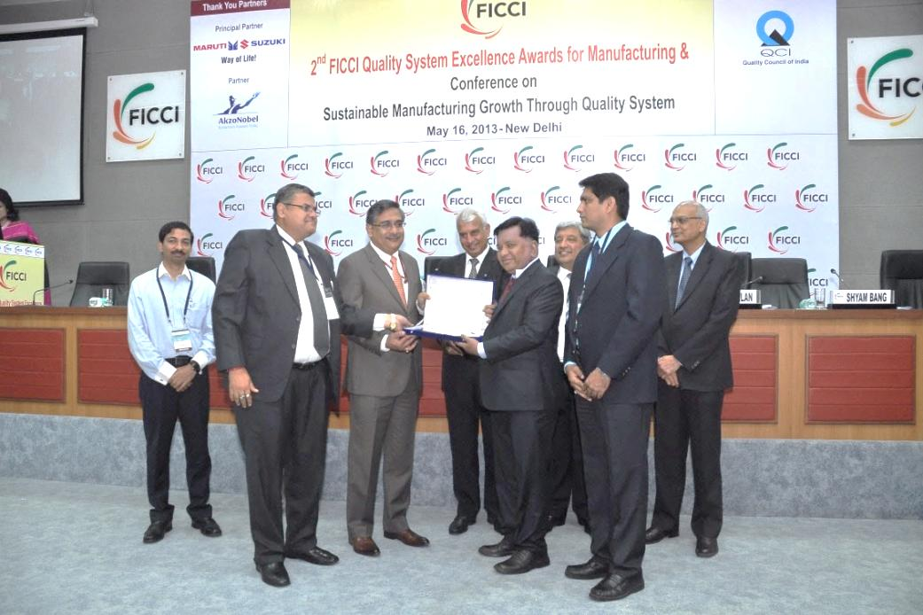
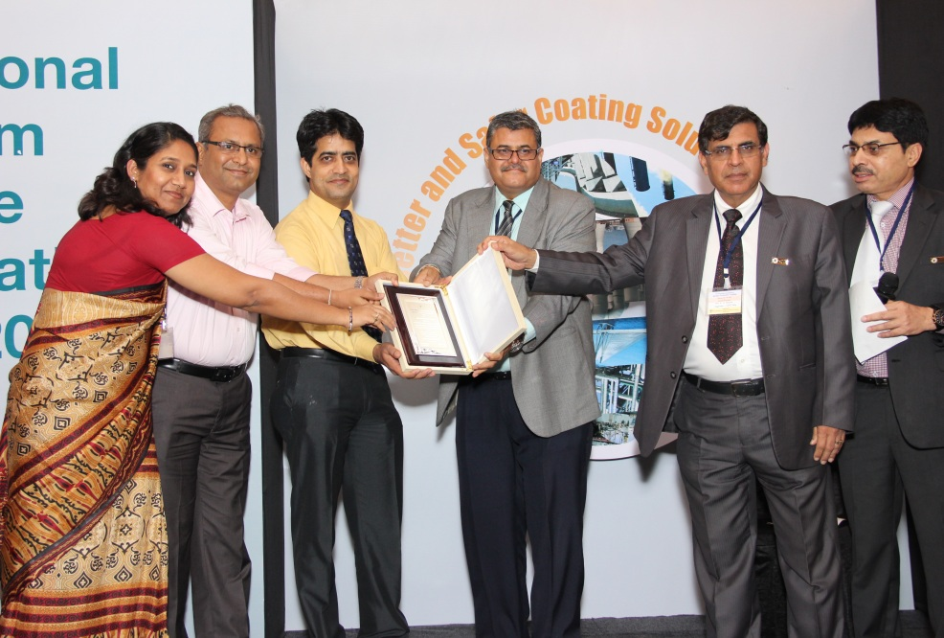
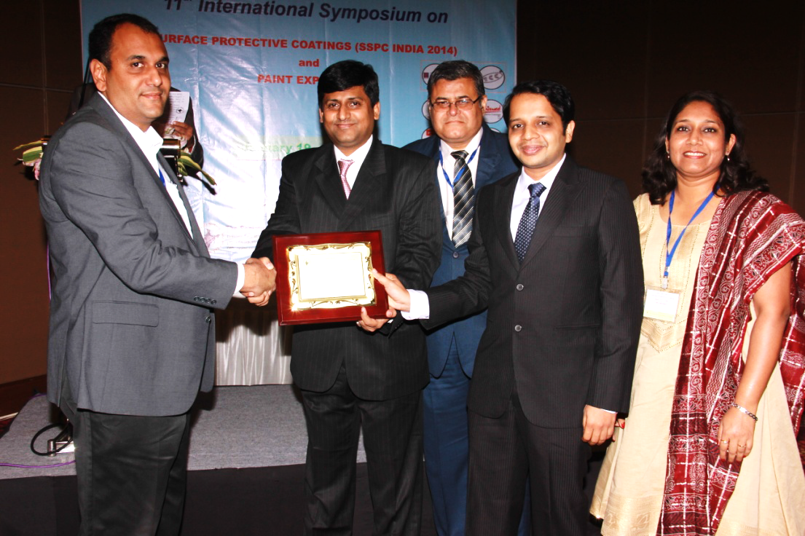
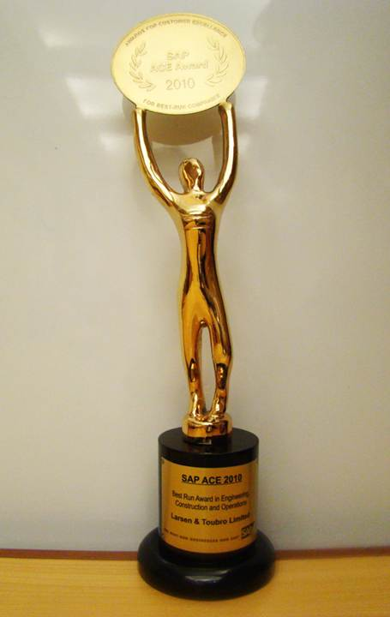
Quality Awards Won By L&T
FICCI Quality System Excellence Award
Special award for Excellence in Coating Application at 10th international symposium on Surface Protective Coatings
SSPC India confers “Best New Technology of the Year Award 2013‐14” to L&T for employing Thermal Spray process for offshore structures for GSPC DDW1 and PLQP Projects
SAP Honors L&T E&C Division with Award for Customer Excellence-2010

Slide 24
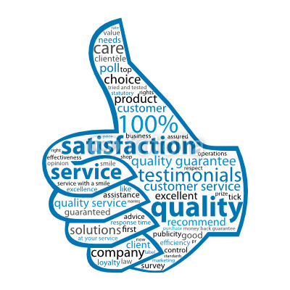
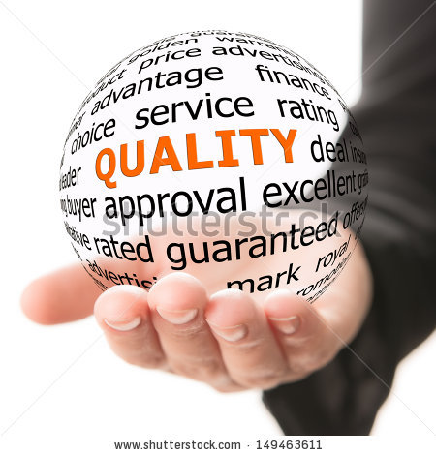
“Leading quality organizations are integrating the voice of the customer across the enterprise, actively managing customer perceptions and delivering unparalleled service; through an inspired, motivated and empowered workforce.”

Slide 25


Slide 26
