Slide 1
HELICOPTERS IN EMERGENCY MEDICAL SERVICES CHALLENGES & OPPORTUNITIES

Slide 2
SCOPE
INTRODUCTION
WHY USE HELICOPTERS
MEDEVAC CAPABLITIES OF IAF HEPTRS
TYPES OF MEDEVAC ROLES BY IAF
STATISTICS FROM RECENT PAST
MEDEVAC PHILOSOPHY IN IAF
PROCEDURE FOR INDENTING IAF AIRCRAFT
CHALLENGES AND CONSTRAINTS
OPPORTUNITIES FOR GROWTH OF HELICOPTER OPS
ROLE OF STATE GOVTS
CONCLUSION

Slide 3
RESCUE AT NANDA DEVI JUNE 2019
INDIA’S SECOND HIGHEST PEAK AFTER KANCHENJUNGA
ELEVATION 25643 FT
PRONE TO AVALANCHES
Nanda Devi
KEDARNATH
Almora
Pithoragarh
Nainital

Slide 4
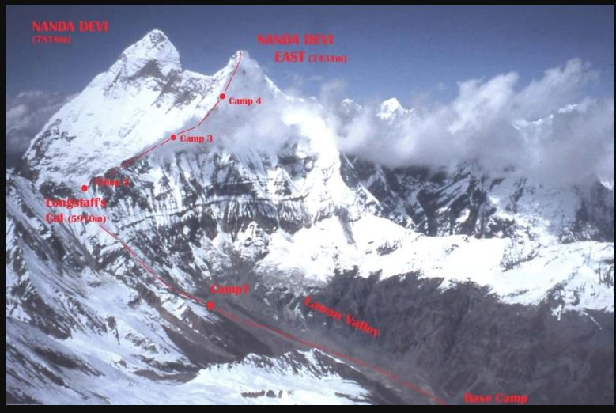
THE MISSION
01 JUN 19 - SOS RECEIVED FROM UTTARAKHAND GOVT
SITUATION: TEAM OF 12 TREKKERS (BRITISH NATIONALS) STUCK DUE TO AVALANCHE AT NANDA DEVI PASS
02 JUN 19 – TWO HEPTRS LAUNCHED
ENTIRE AREA IS SEARCHED AND 4 TREKKERS FOUND AT BASE CAMP. THEY ARE RESCUED
BASE CAMP

Slide 5
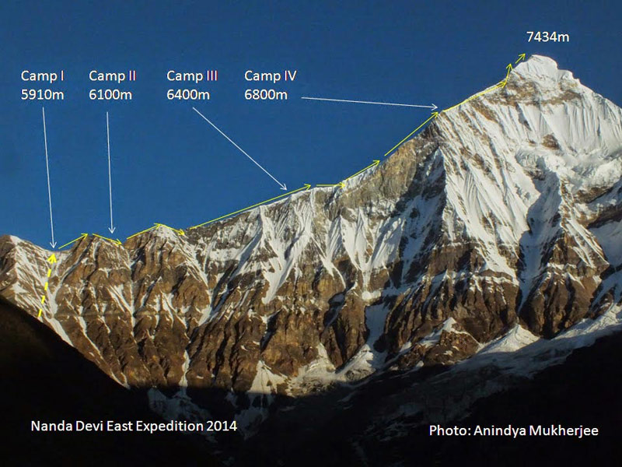
THE MISSION
SEARCH CONTINUES ON DAY 2
FRESH SNOW DUE TO AVALANCHE MAKES IT DIFFICULT TO IDENTIFY ANYTHING. FINALLY TELL TALE INDICATIONS ARE SEEN
DURING THE NEXT WEEK , TWO ATTEMPTS TO RECOVER THE BODIES FAIL DUE TO HIGH ALTITUDE , SNOW AND UNFORGIVING WEATHER CONDITIONS
SUBSEQUENTLY ITBP TEAM IS INDUCTED FOR RECOVERY OF BODIES

Slide 6
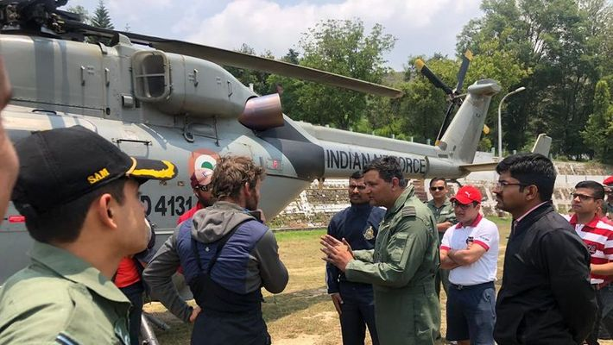
THE MISSION
BODIES BROUGHT TO GLACIATED PART OF NANDA DEVI
03 Jul 19 – TOTAL 07 BODIES RECOVERED BY HELICOPTERS
ENTIRE SEARCH AND RECOVERY OF MORTAL REMAINS TOOK A MONTH 02 JUN TO 03 JUL

Slide 7
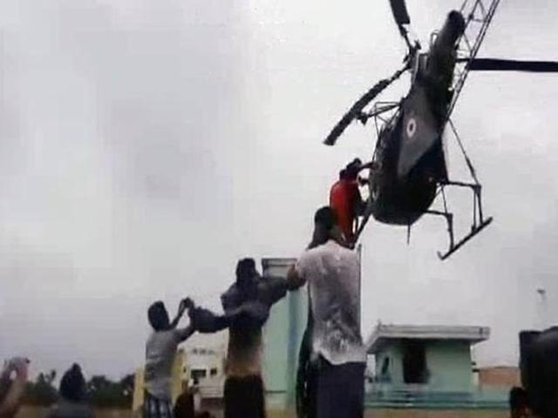
MED EVAC
Medical evacuation by air is a faster, safer, efficient mode of patient transport to save life and limb. Aim is to make the patient reach a specialized facility within the “Golden Hour”
CHENNAI FLOODS DEC 2017 PREGNANT LADY EVACUATED FROM ROOF TOP

Slide 8
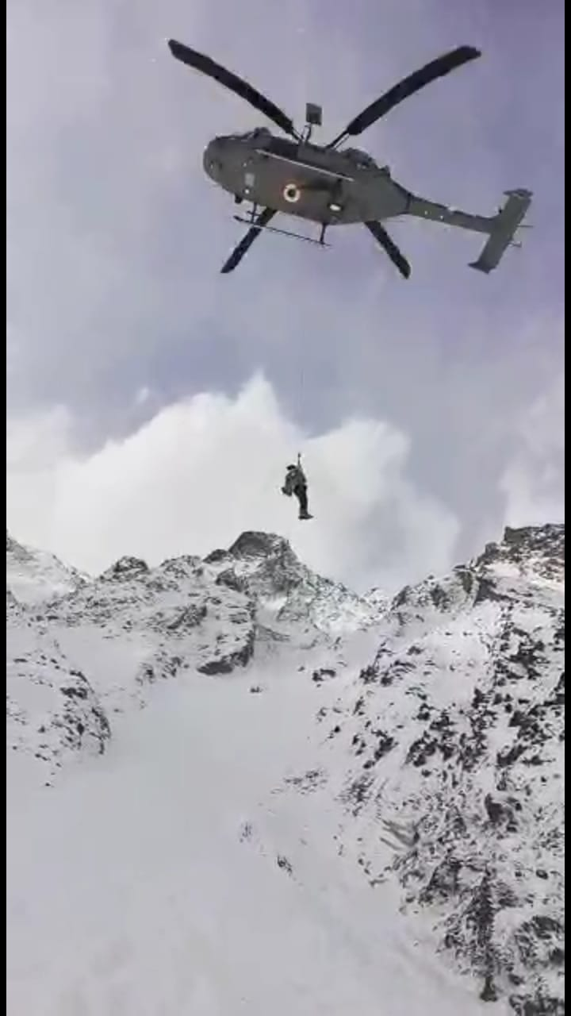
WHY USE HELICOPTERS ?
FLEXIBILITY
REACH
VERSATILITY
AGILITY
MEDEVAC OF 18 ITBP SOLDIERS IN FEB 2019 IN HARSIL (UTTARAKHAND )
“Most suitable platform for Rescue and Evacuation tasks in Time and Space critical situations”

Slide 9
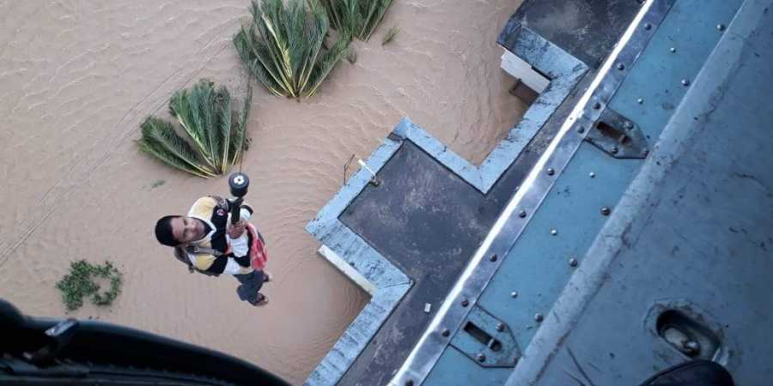
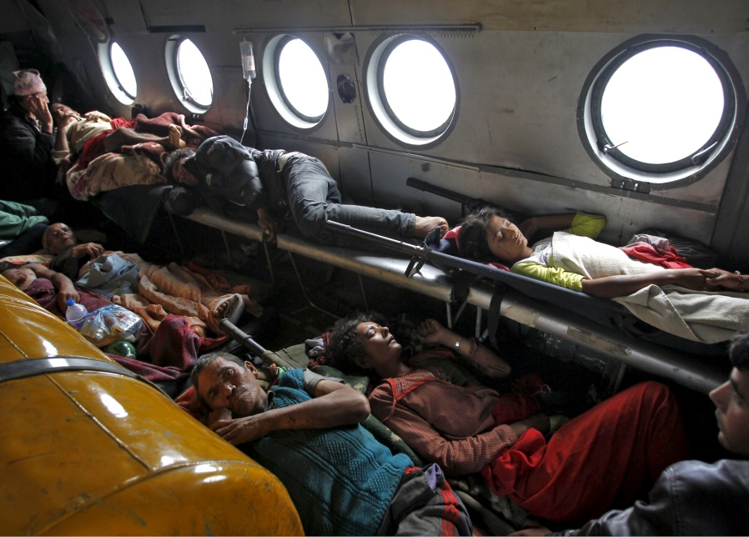
TYPES OF MEDEVAC ROLES BY IAF
PERSONNEL FROM FORWARD AREAS
CASULTY/ PATIENTS FROM ONE HOSPITAL TO ANOTHER
ERRANDS OF MERCY DURING DISASTERS
TRANSPORTATION OF HUMAN ORGANS FOR TRANSPLANTATION
BIHAR FLOODS EVACUATIONS 2019

Slide 10
STATISTICS
MEDEVACS BY IAF HEPTRS
YEAR | 2015-16 | 2016-17 | 2017-18 | 2018-2019
MEDEVAC | 365 | 348 | 288 | 251
AGENCY | FOREIGN NATIONALS | PARA MILITARY | POLICE | STATE GOVT
NUMBERS | 29 | 655 | 61 | 365

Slide 11
STATISTICS
HADR RESCUE OPERATIONS
YEAR | 2015-16 | 2016-17 | 2017-18 | 2018-19 | 2019-20 TILL DATE
NUMBERS | 6701 | 515 | 1000 | 2470 | 1061

Slide 12
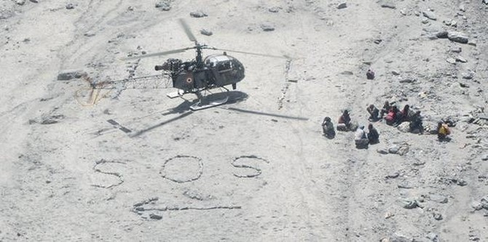
MEDEVAC OF FOREIGN NATIONALS
29 FOREIGN NATIONALS EVACUATED FROM HIGH ALTITUDES IN LAST 5 YEARS
22 BRITISH AND FRENCH TREKKERS RESCUED FROM LADAKH 08 AUG 15

Slide 13
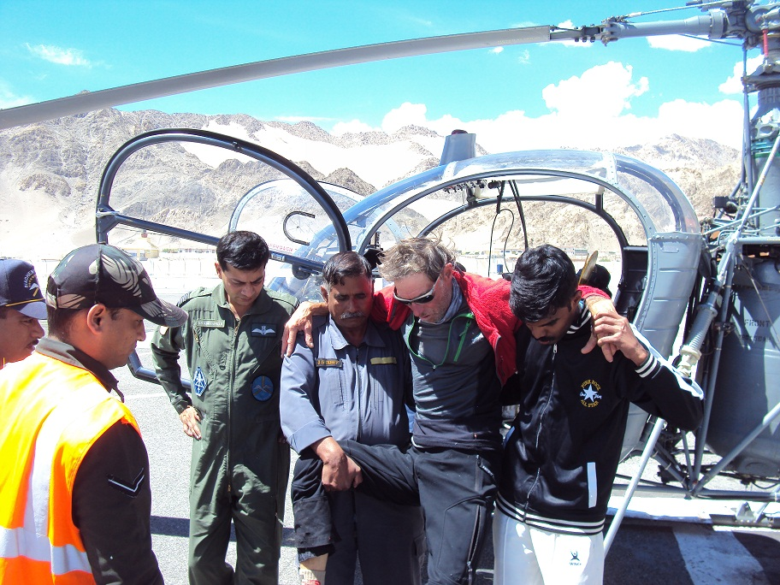
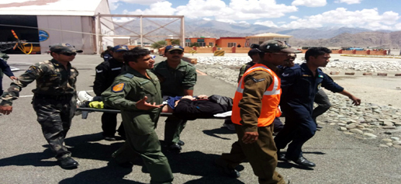
MEDEVAC OF FOREIGN NATIONALS
RESCUE OF BRITISH NATIONAL FROM LEH 2014
JUL 2016
2 BELGIUM NATIONALS EVACUATED FROM LEH

Slide 14
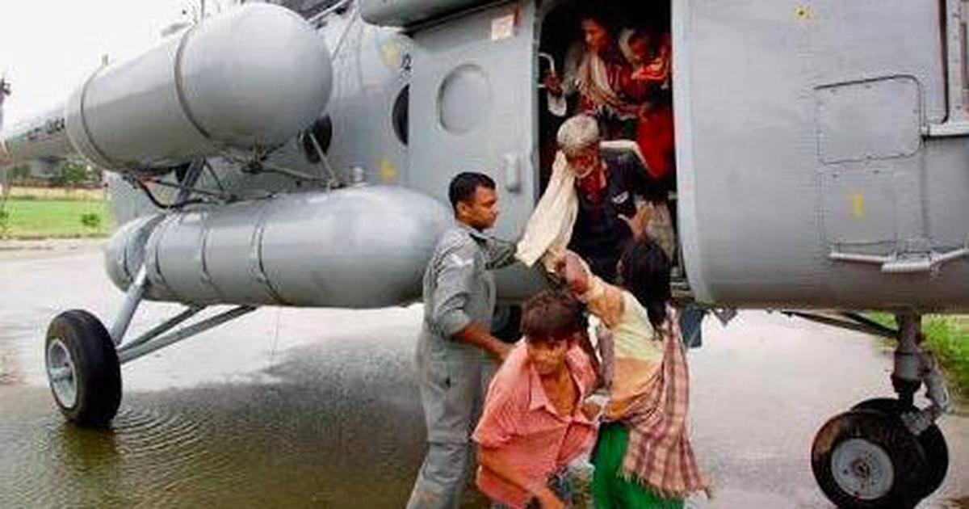
MEDEVAC DURING DISASTERS
OP MEGH RAHAT IN J &K (2014)
19719 CITIZENS EVACUATED

Slide 15
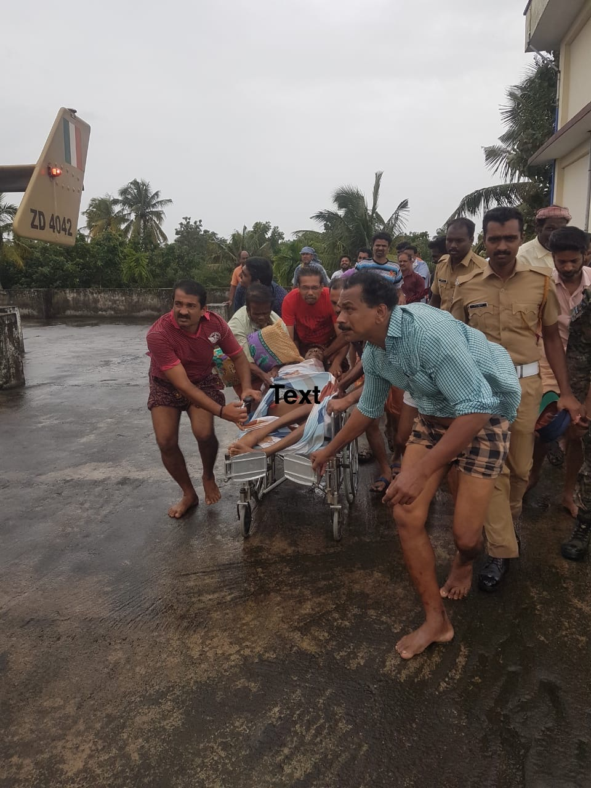
MEDEVAC DURING DISASTERS
MEDEVAC FROM ROOF TOP KERALA FLOODS 2018
27 HEPTRS EMPLOYED BY IAF IN RESCUE MISSIONS

Slide 16
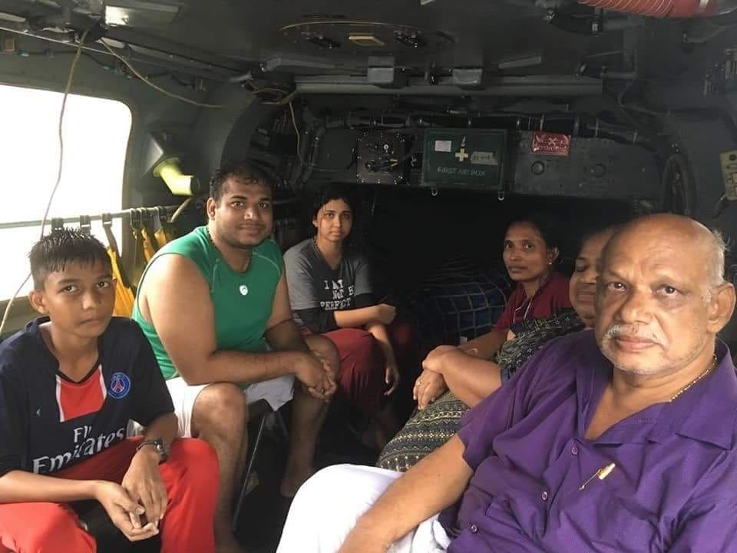
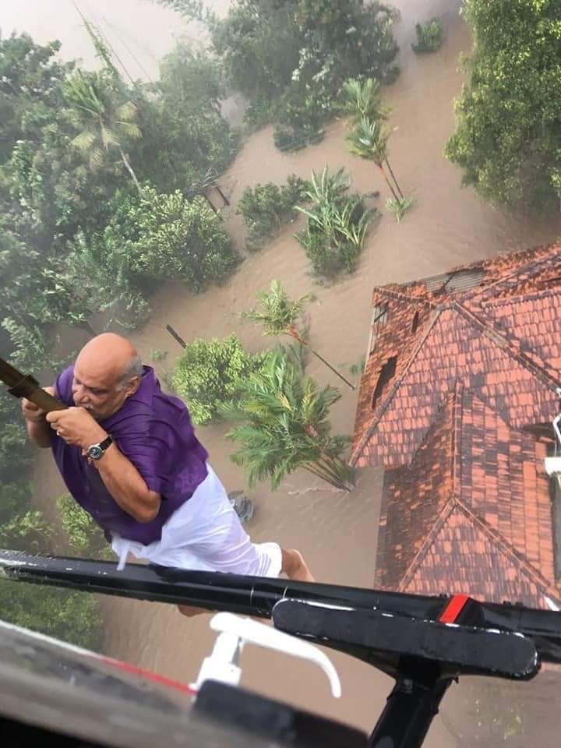
KERALA 2018
584 PEOPLE EVACUATED, MAJORITY OF THEM CASUALTIES

Slide 17
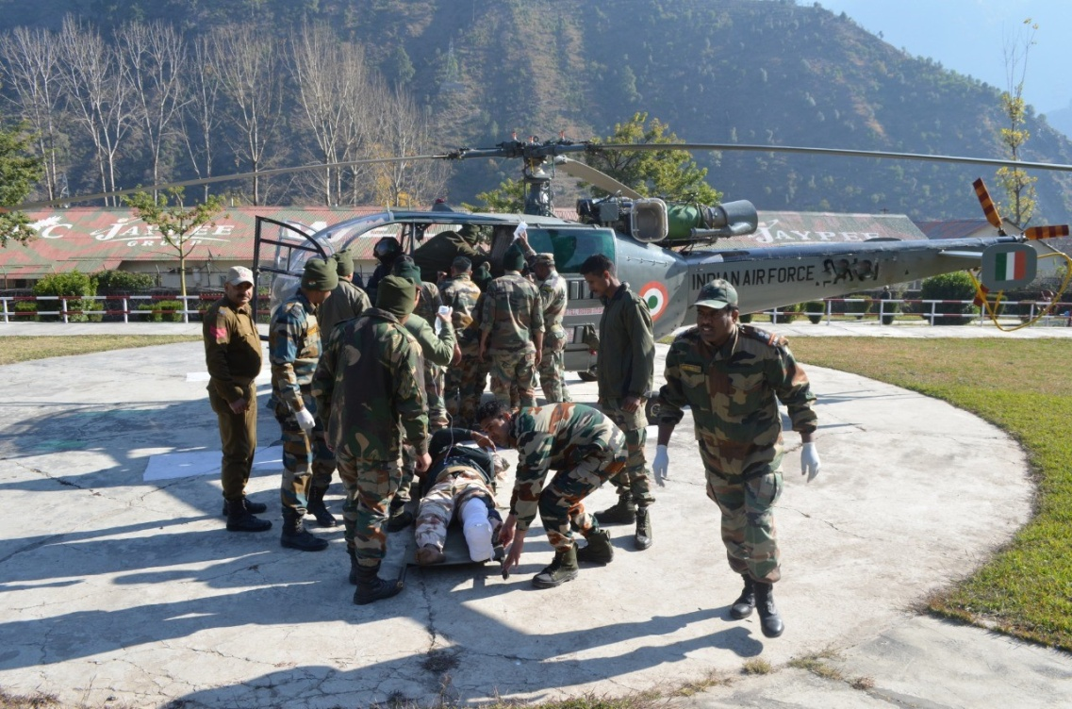
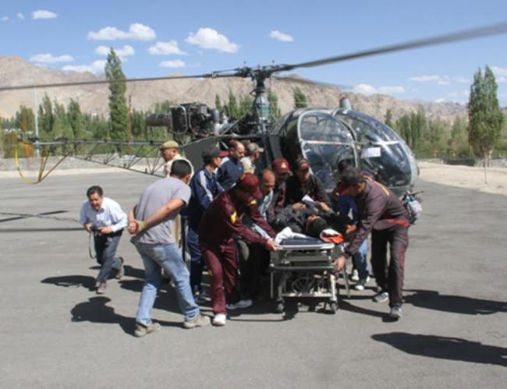
MEDEVAC OF PARA MILITARY SOLDIERS
655 PARA MILITARY PERSONNEL EVACUATED IN LAST 5 YEARS

Slide 18
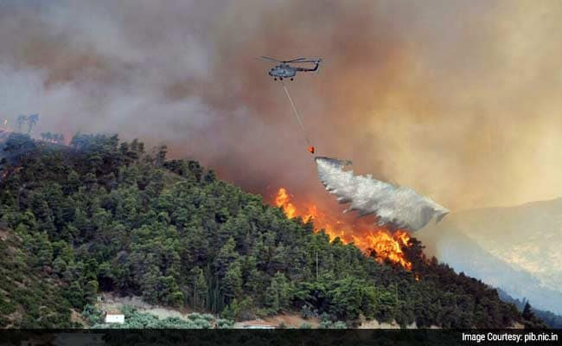
FOREST FIRES
IAF REQD TO PITCH IN TO DOUSE FOREST FIRES
TAMIL NADU - MAR 2018
KATRA - MAY 2018
PATHANKOT - MAY 2018
KASUALI MAY - 2018
MOUNT ABU - APR 2017
KOTA - APR 2017
VISHAKHAPATNAM NOV 2014

Slide 19
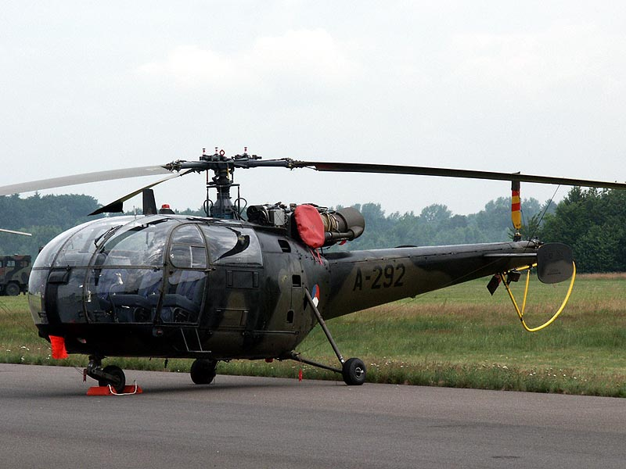
IAF HEPTRS – CAPABILITIES
MLH VARIANTS - STRETCHER CASUALTY 12 + MEDICAL ATTENDANTS 3
ALH VARIANTS - STRETCHER CASUALTY 04 + MEDICAL ATTENDANTS 3
LUH VARIANTS - STRETCHER CASUALTY 02 + MEDICAL ATTENDANTS 1

Slide 20
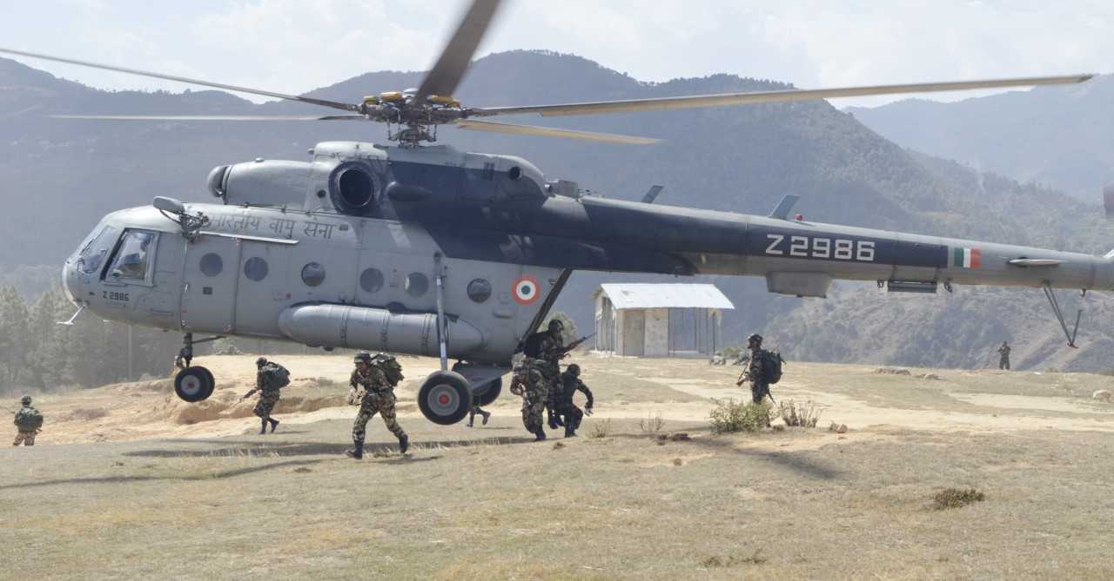
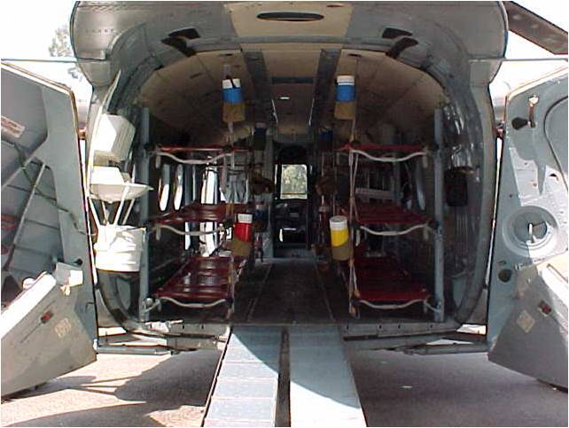
IAF HEPTRS MODIFIED FOR MEDEVAC ROLE
MACHINES DESIGNED FOR MILITARY USE
Mi-17 HELICOPTER
MODIFIED TO UNDERTAKE MEDEAVC TASKS WITH BASIC EQPT
TIME TO MODIFY – 3-4 HOURS

Slide 21
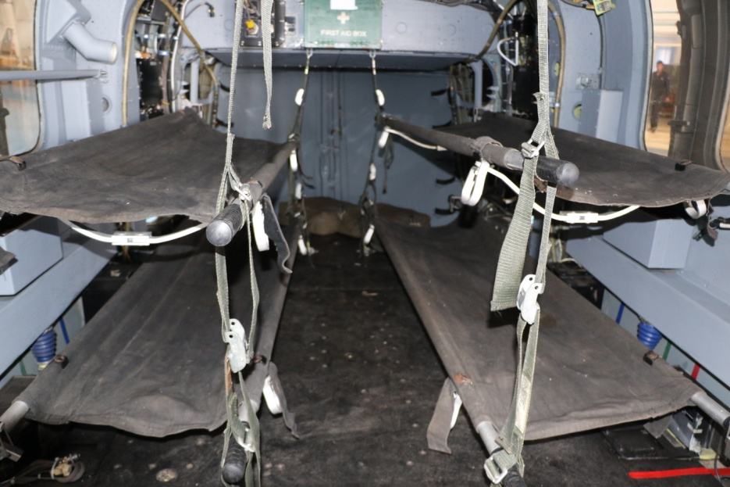
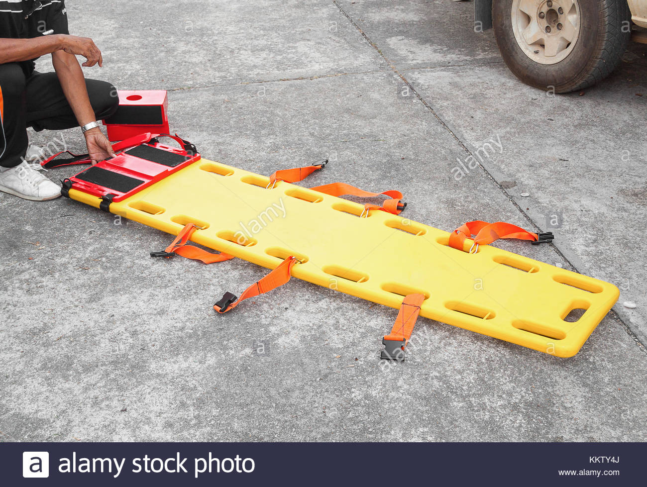
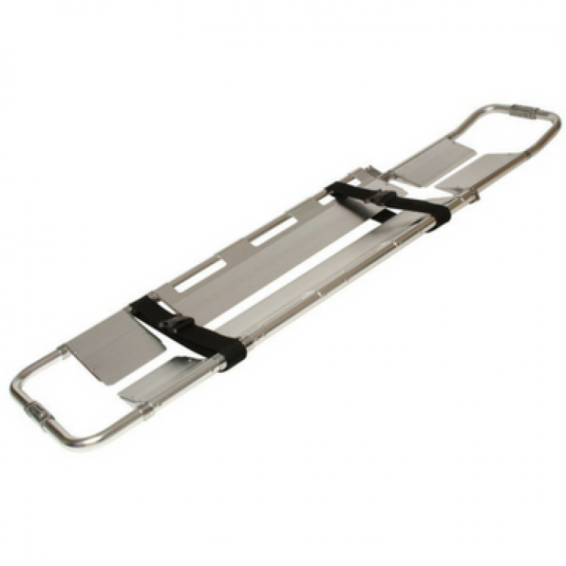
MEDEVAC EQUIPMENTS
BASIC STRETCHER
SPINAL BOARD: STRETCHER FOR SPINAL SUPPORT
OTHER EQUIPMENT
SEATS FOR MEDICAL ATTENDANTS
OXYGEN BOTTLES
SPECIALIST MEDICAL CARE EQUIPMENT: VARIES DEPENDING ON SITUATION
SCOOP STRETCHER

Slide 22
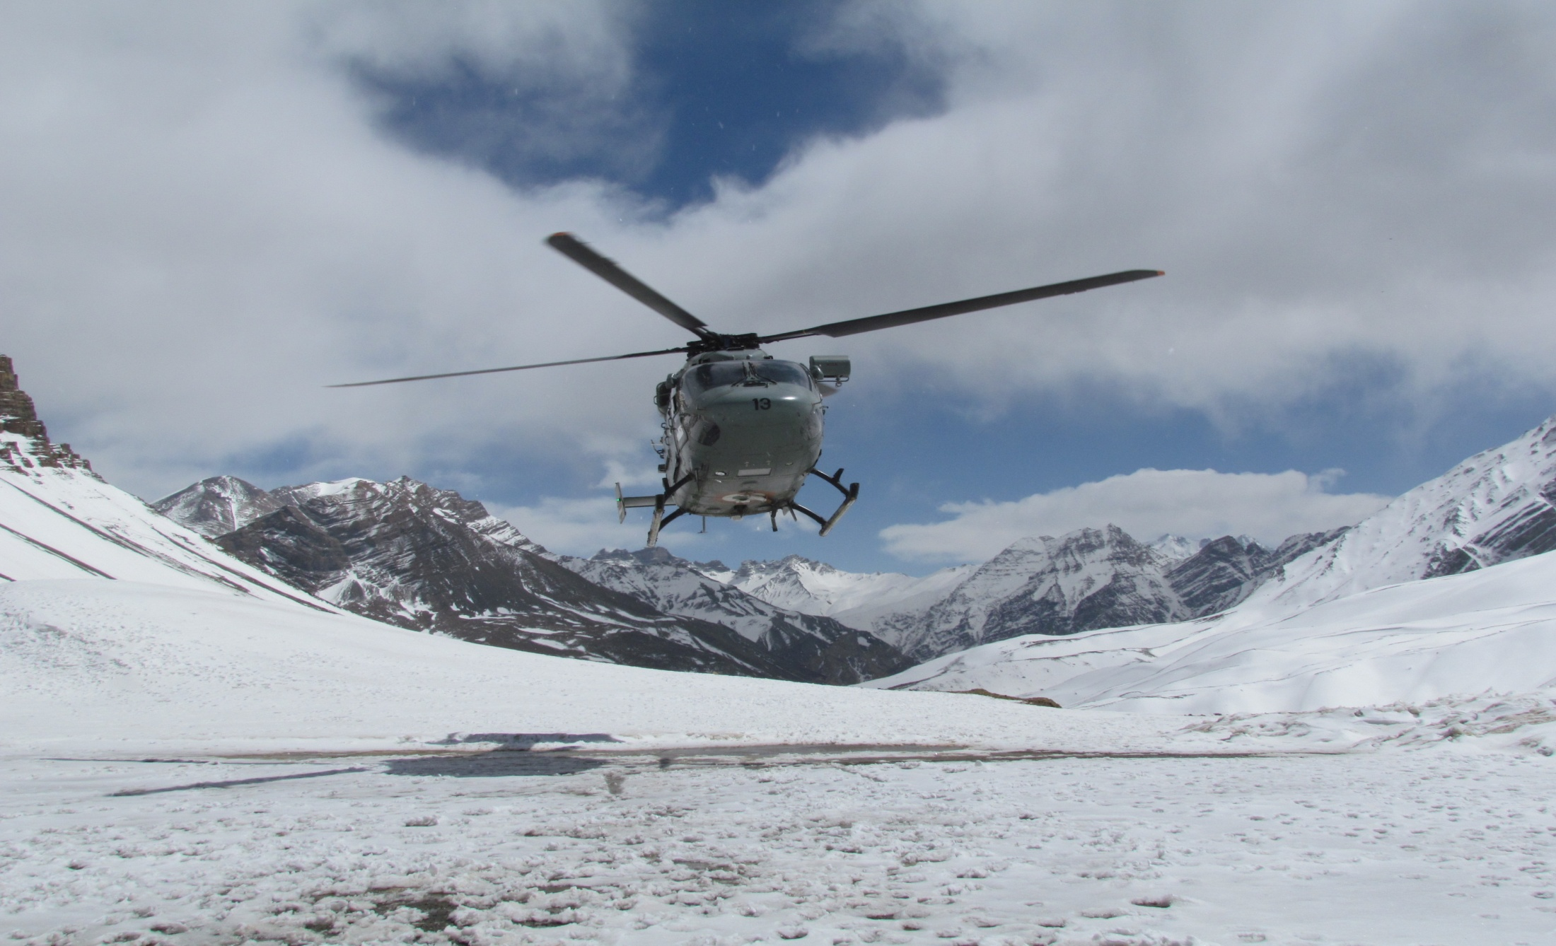
MEDEVAC PHILOSOPHY IN IAF
EXECUTION PROCEDURE
REQUISITION FOR MEDEVAC FROM STATE GOVTS, BSF, MEA FOR FOREIGN NATIONALS
COORDINATION BETWEEN CONCERNED AGENCIES
FITNESS FOR AIR EVACUATION BY DOCTOR
INSTITUTION OF URGENT MEDICAL AID
BRIEFING AND EVACUATION OF CASUALTY

Slide 23
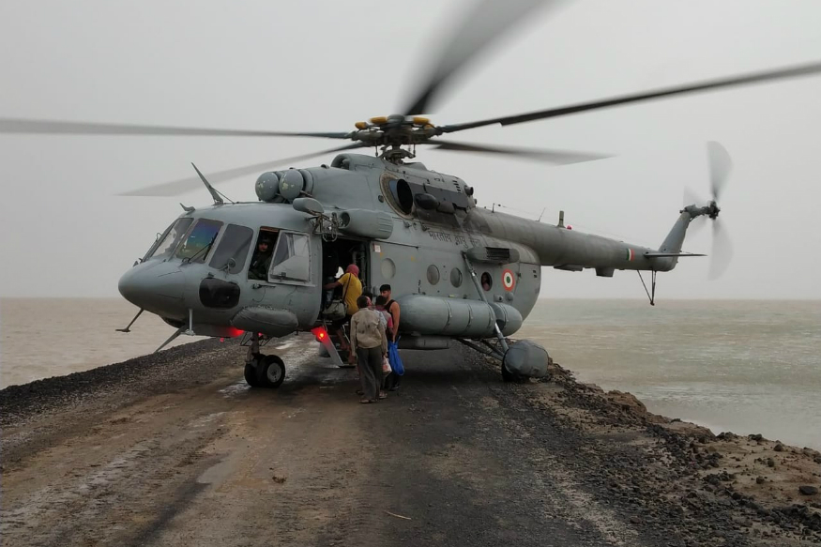
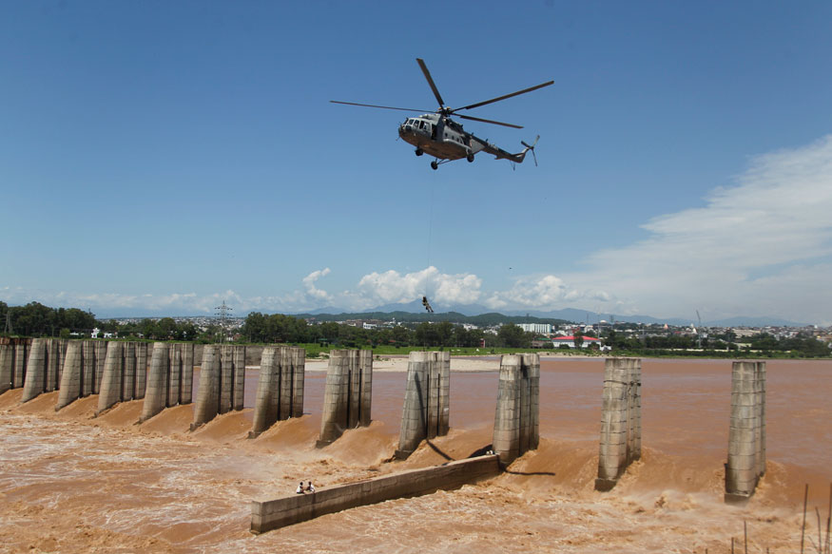
MEDEVAC PHILOSOPHY IN IAF
TEAM WORK BY MEDICAL & FLYING PROFESSIONALS
PRIORITIES FOR EVACUATION - DEPENDS ON CRITICALITY OF MEDICAL CARE REQD
PRIORITY I TO PRIORITY IV IS SET : RANGING FROM LIFE SAVING MEASURE TO MATTER OF CONVENIENCE
GUJARAT 2017
JAMMU AUG 2019

Slide 24
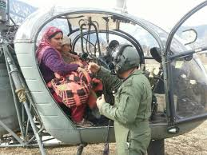
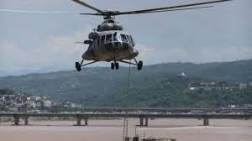
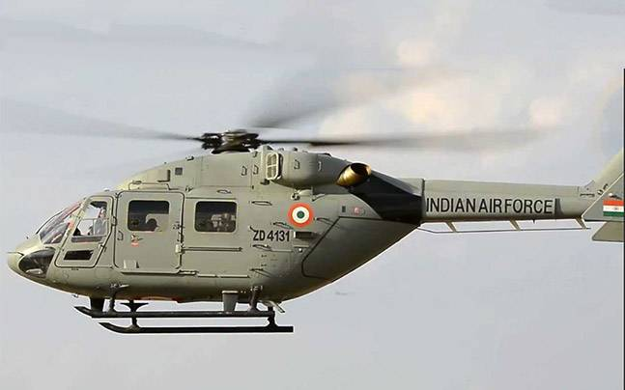
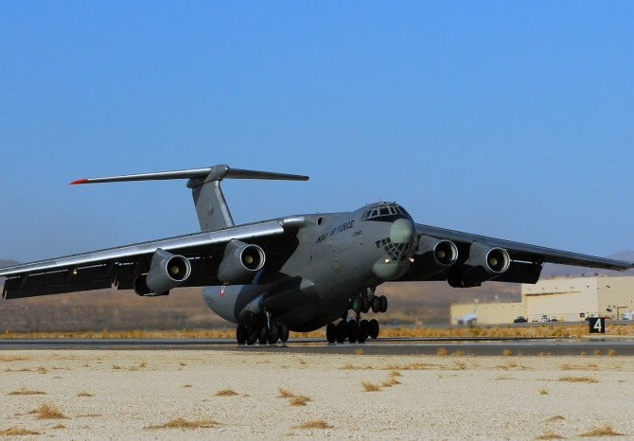
INTEGRATED BROAD PLAN FOR MASS CASUALTIES
BIGGER
AIRBASE
TERTIARY CARE

Slide 25
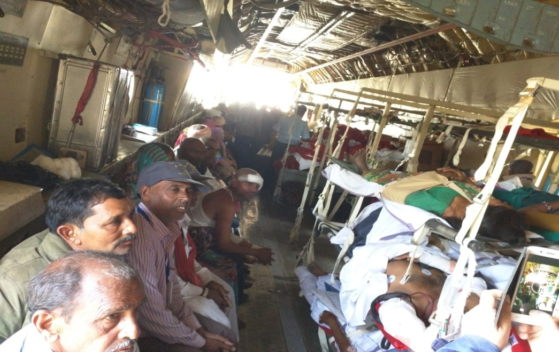
INTEGRATED BROAD PLAN FOR MASS CASUALTIES
PATIENTS MOVED TO BIGGER CITIES WITH TERTIARY CARE FACILITIES IN TRANSPORT AIRCRAFT
MOCK DRILL MASS EVACUATION
MASS CASEVAC BY C-17

Slide 26
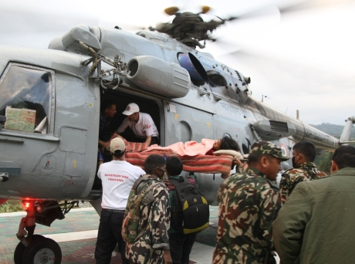
PROCEDURE FOR INDENTING IAF AIRCRAFT
STATE GOVT/ CONCERNED AGENCY REQUESTS MOD ( JS AIR)
MOD APPROVES AND INFORMS THE SAME TO IAF
TASK UNDERTAKEN AFTER MOD CLEARANCE.
IN CASE OF URGENT REQUIREMENTS THE REQUESTS ARE MADE TELEPHONICALLY AND TASK UNDERTAKEN.

Slide 27
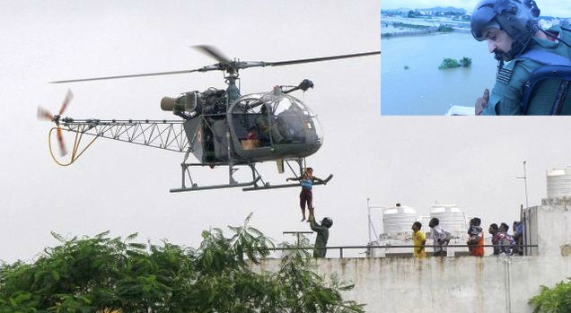
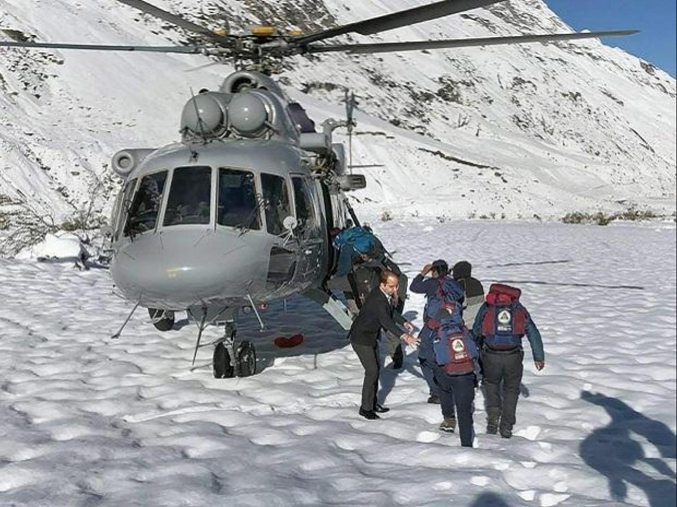
COST OF INDENTING HEPTR
IAF HELICOPTERS
RANGES FROM 2 TO 7 Lakhs
ON HOURLY BASIS

Slide 28
CHALLENGES
ARMED FORCES HAVE MULTIPLE ROLES
DEDICATED HEPTRS FOR MEDEVAC ROLE – NOT POSSIBLE
HEPTRS / AC ARE MODIFIED AS PER REQUIREMENT
VAST GEOGRAPHICAL AREA TO BE COVERED
TERRAIN, ALTITUDE – HEPTR CAPABILITIES REDUCE
EXTRACTION OF MORTAL REMAINS FROM CRASH SITES – DIFFICULT TO REACH LOCATIONS

Slide 29
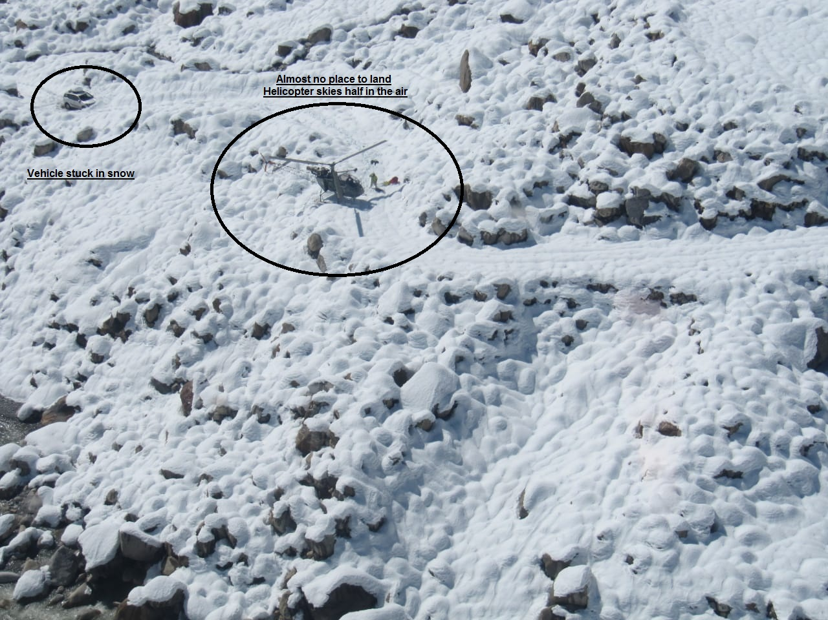
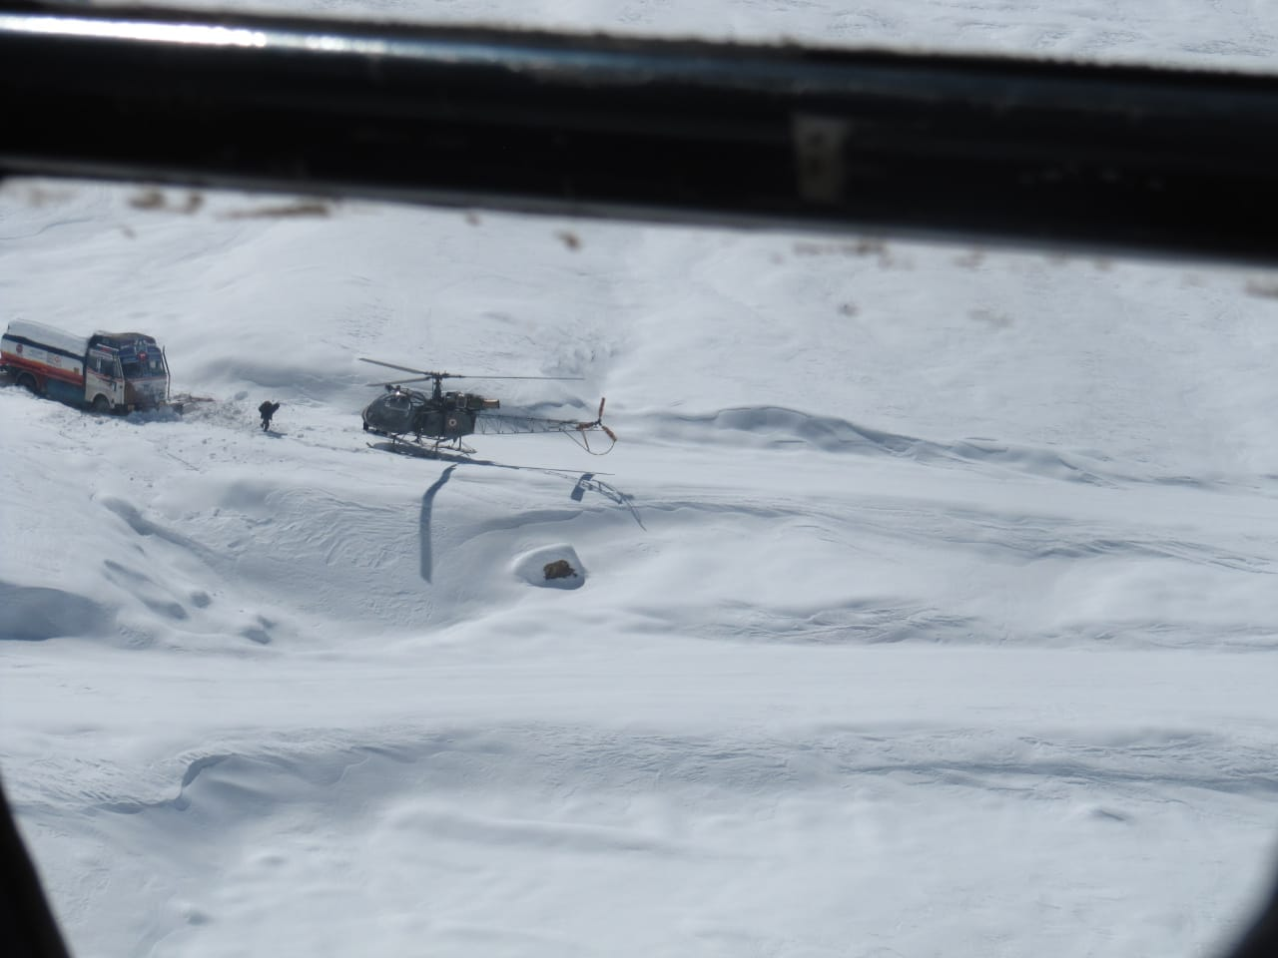
CHALLENGES
DIFFICULT TERRAIN
NO LANDING SITE, HEPTR IN AIR
VEHICLE STUCK IN SNOWFALL
VEHICLE STUCK IN AVALANCHE

Slide 30
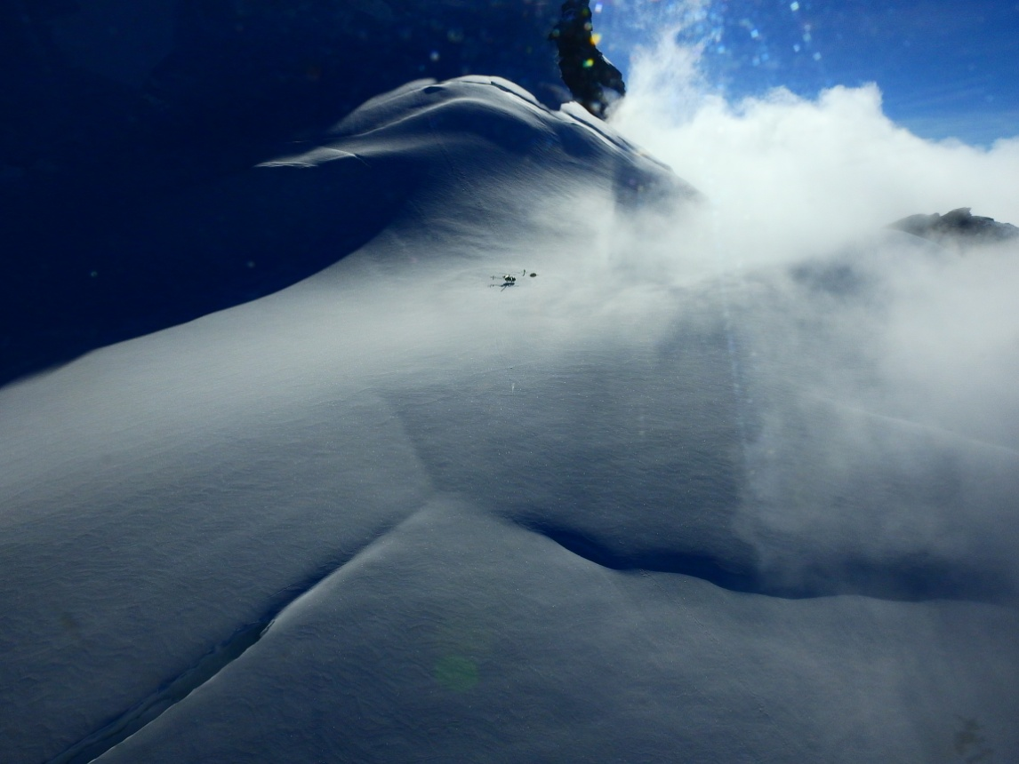
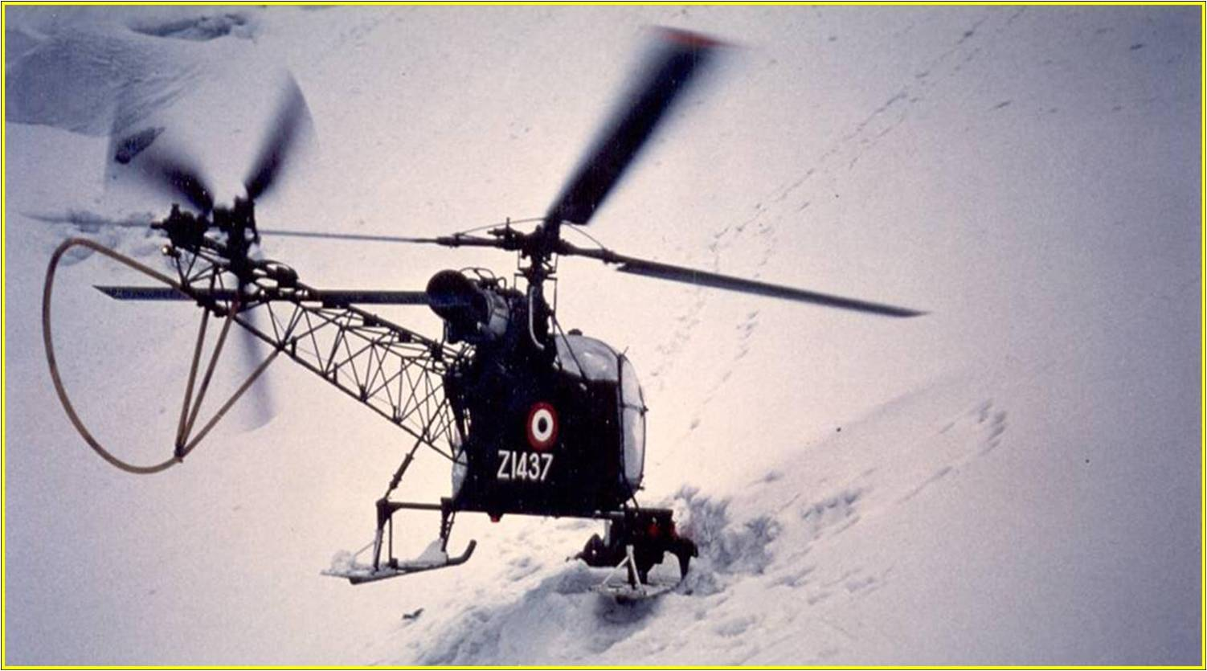
CHALLENGES
11 May 2004
CASEVAC FROM Mt KAMET GLACIER AT 23,260 ft – 3 MOUNTAINEERS RESCUED BY WG CDR SK SHARMA
LIMCA BOOK OF WORLD RECORDS FOR HIGHEST EVER LANDING AND CASUALTY EVACUATION BY HEPTR
HEPTR CAPABILITIES REDUCED AT HIGH ALTITUDE, STRONG TURBULENT WINDS
NO LANDING SPACE DUE SOFT SNOW

Slide 31
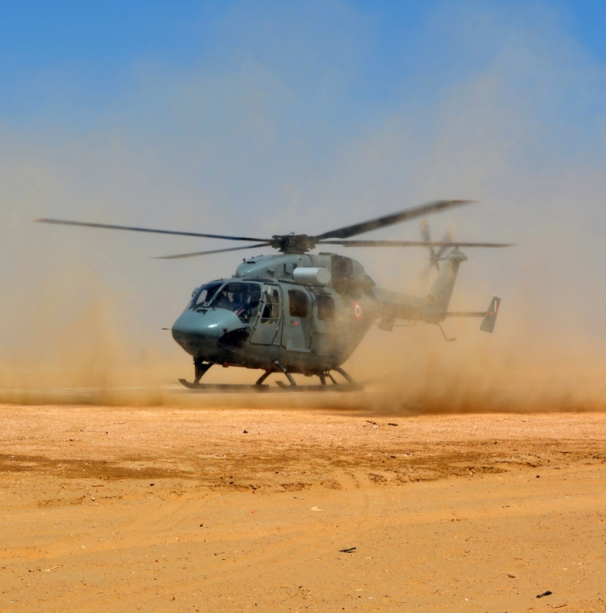
CONSTRAINTS FOR ONBOARD MEDICAL AID
NOISE AND VIBRATION IN HEPTRS
DISTURBS TREATMENT/ MEDICAL PROCEDURES ONBOARD
IMPAIRS COMMUNICATION
AIR SICKNESS
HYPOXIA
TEMPERATURE – WITH INCREASE IN ALTITUDE REDUCES BY 2 deg C/ 1000 FT
RATE OF ASCENT/ DESCENT AND ALTITUDE EFFECTS

Slide 32
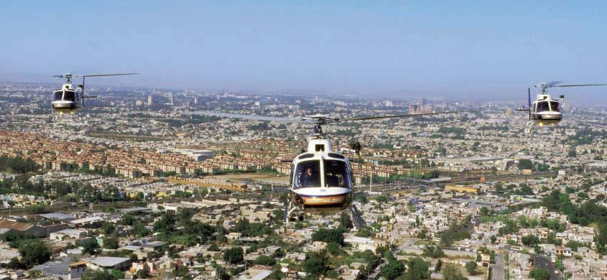
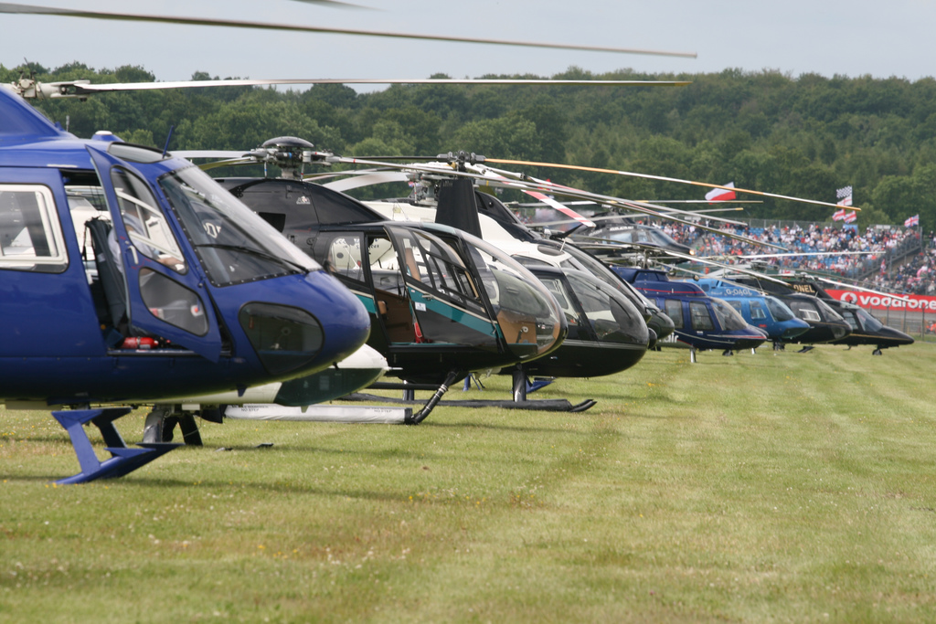
OPPORTUNITIES - HELICOPTER GROWTH
AFTER 65 YEARS, APPROX 270 CIVIL REGISTERED HEPTRS
WORLD POPULATION OF CIVIL HEPTRS - 34,550
INDIAN HOLDING LESS THAN 1%
SAO PAULO IN BRAZIL HAS 500 HEPTRS
USA CIVIL HEPTRS 9700, USA MILITARY 6100
EMERGENCY MEDICAL SERVICES – HUGE OPPORTUNITY IN INDIA

Slide 33
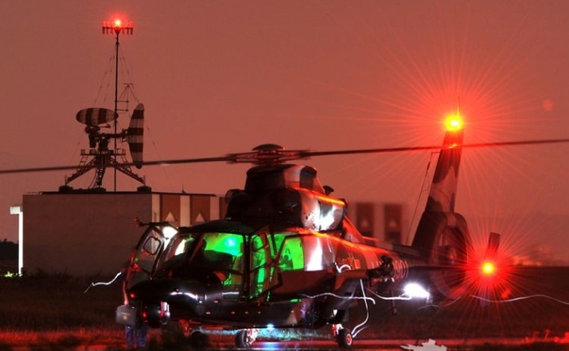
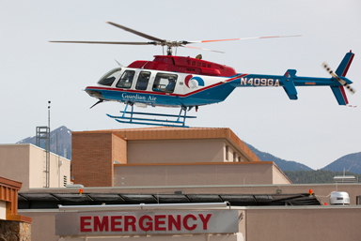
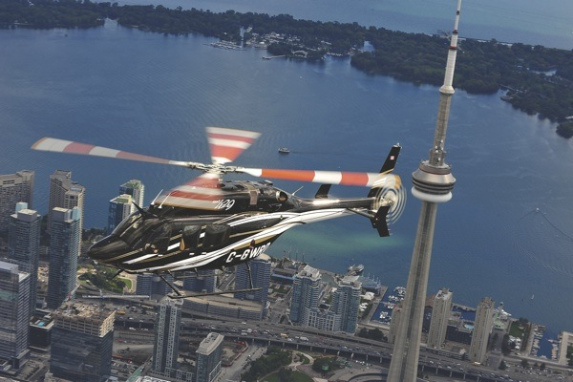
ROLE OF STATE GOVTS
CREATION OF DISASTER RELIEF INFRASTRUCTURE
STATE GOVTS CAN HAVE NODAL PLACES WHERE EQPT AVAILABLE
ROOFTOP OPS OF EMERGENCY MEDICAL SERVICES/ CORPORATE HELICOPTERS
TIE-UP OF HELICOPTER MEDEVAC WITH INSURANCE COMPANIES
IMPROVED HEALTHCARE IN REMOTE AREAS
APPROPRIATE NAVAIDS FOR NIGHT OPS

Slide 34
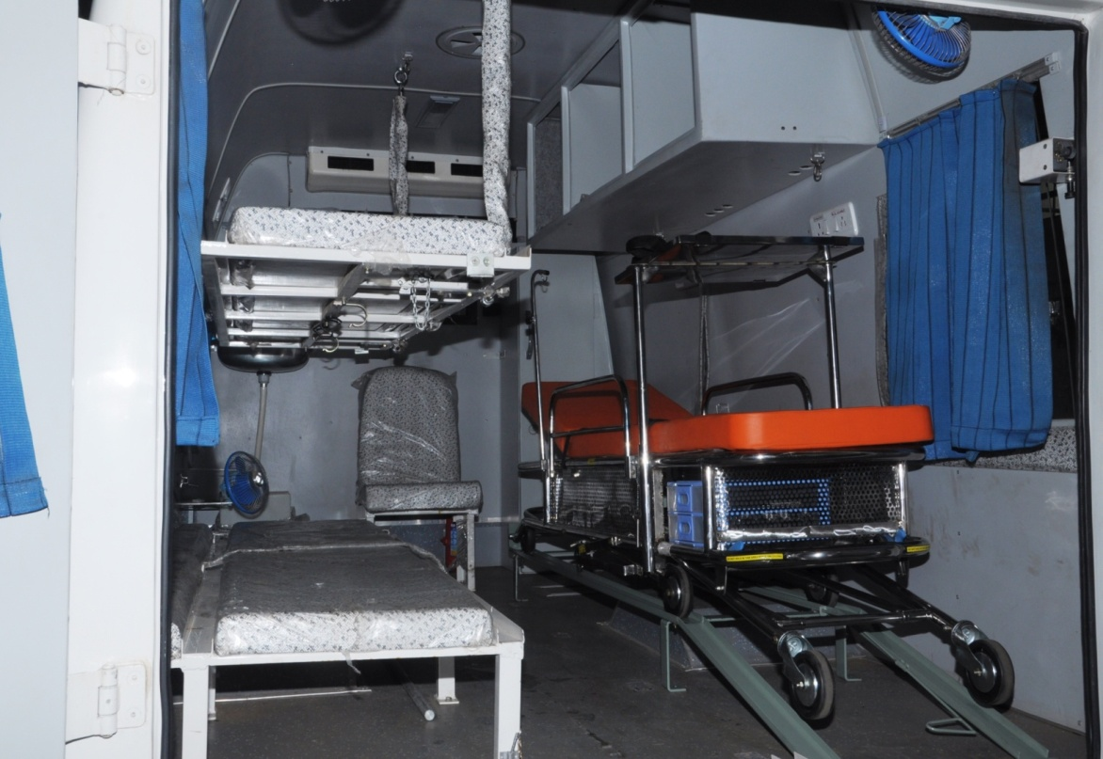
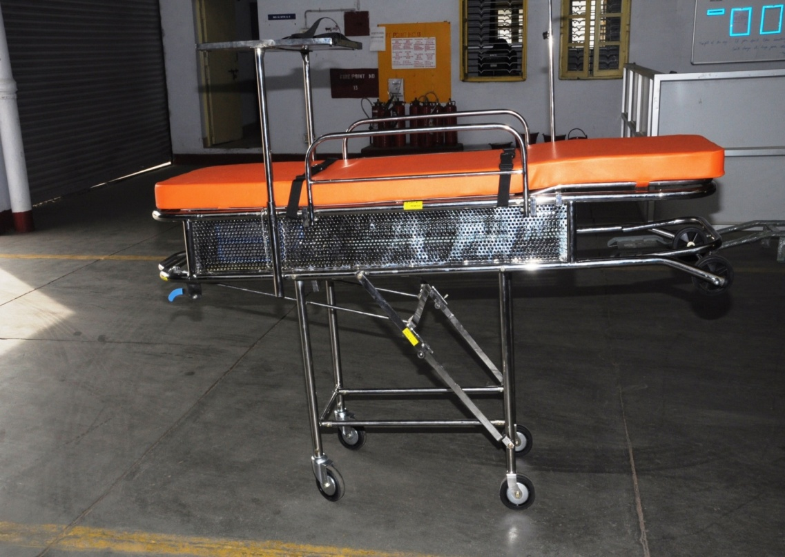
MODERN EQUIPMENTS
INTEGRATED STRETCHER ON WHEELS WITH MEDICAL SUPPORT EQPT – CAN FIT INTO AIRCRAFT AND AMBULANCES
EQPTS CAN BE UTILISED BY MEDEVAC AGENCY ON REQUIREMENT BASIS
PATIENT TRANSFER UNITS

Slide 35
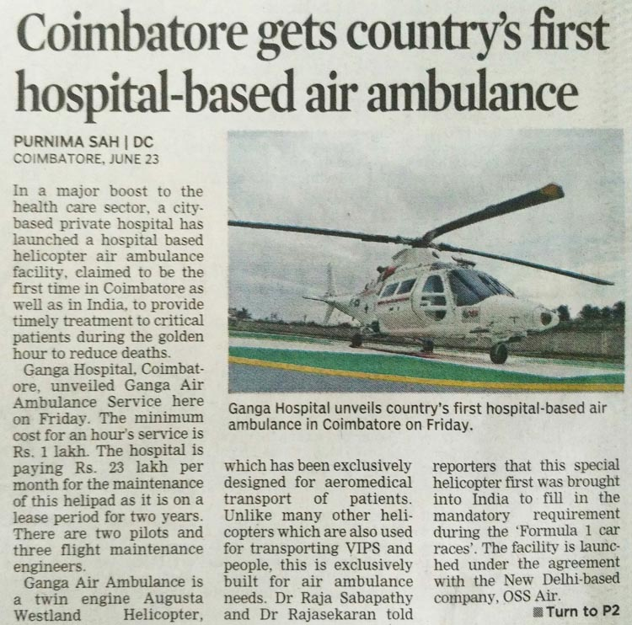
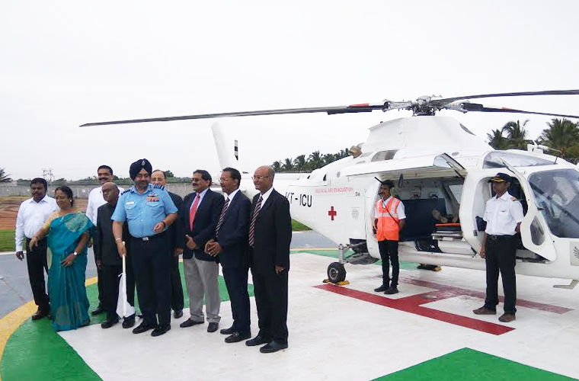
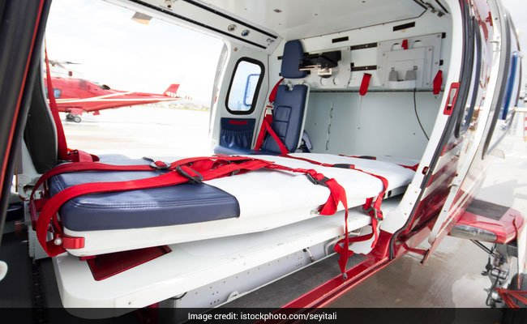
WAY AHEAD
CHIEF OF AIR STAFF INAUGURATES AIR AMBULANCE OF GANGA HOSP: COIMBATORE

Slide 36
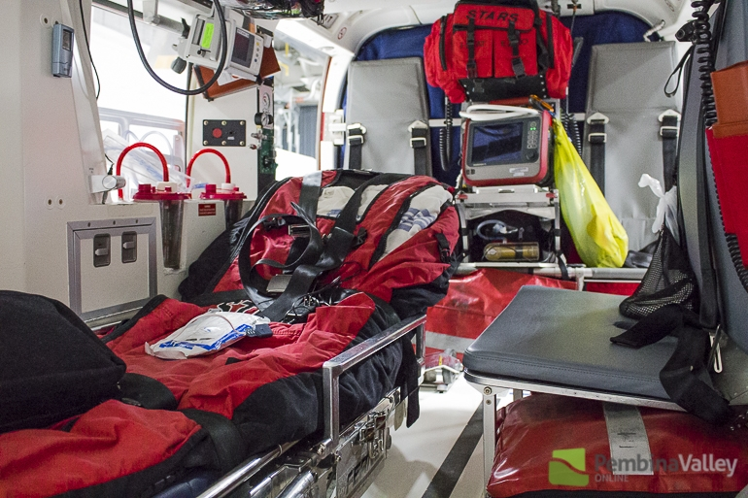
THE FUTURE

Slide 38
QUESTIONS ?

